Slide 1
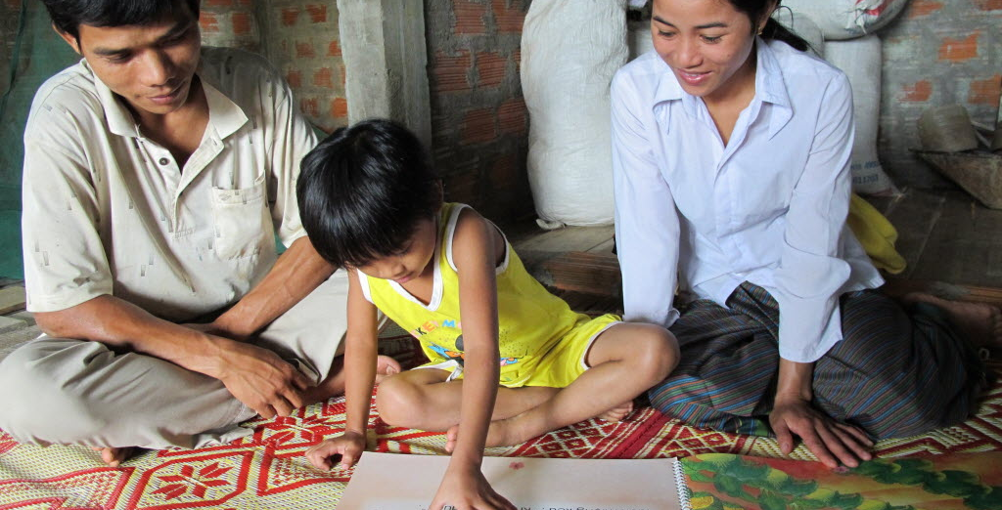
VIETNAM SPONS ECD MIDLINE RESULTS

Slide 2
Thank you to our team of assessors!

Slide 3
Table of Contents
Context
Research questions
Research Methods
Sample characteristics
Data collection tools
MidLine results
Skills by domains
Home environment
Recommendations

Slide 4
Table of Contents
Context
Research questions
Research Methods
Sample characteristics
Data collection tools
MidLine results
Skills by domains
Home environment
Recommendations

Slide 5
Table of Contents
Context
Research questions
Research Methods
Sample characteristics
Data collection tools
MidLine results
Skills by domains
Home environment
Recommendations

Slide 6
Context
Community characteristics in Lao Cai
Lao Cai is a mountainous province in the north-western area of Vietnam

Slide 7
Table of Contents
Context
Research questions
Research Methods
Sample characteristics
Data collection tools
MidLine results
Skills by domains
Home environment
Recommendations

Slide 8
Research questions
What are the school readiness skills of children in the program between intervention and comparison school from the baseline to MidLine?
How do these skills compare to the skills children in their same cohort started with?
What do the home learning environments of the children look like at MidLine?
How do these compare to the home learning environments of children in their same cohort at baseline?

Slide 9
Table of Contents
Context
Research questions
Research Methods
Sample characteristics
Data collection tools
MidLine results
Skills by domains
Home environment
Recommendations

Slide 10
Research methods
Sample characteristics. General
 | Baseline | MidLine | Grand Total
Comparison
Boy | 88 | 96 | 184
Girl | 76 | 81 | 157
Intervention
Boy | 82 | 85 | 167
Girl | 53 | 77 | 130
Grand Total | 299 | 339 | 638
The sample at MidLine was a new random sample taken at the same centers and following the same baseline cohort but not the same children.

Slide 11
Research methods
Sample characteristics. Ethnicity
Ethnicity | Intervention | Comparison
% Dao | 43% | 43%
% Kinh | 22% | 17%
% Mong | 14% | 14%
% Tay | 7% | 13%
% Nung | 10% | 8%
% Other | 4% | 5%

Slide 12
Table of Contents
Context
Research questions
Research Methods
Sample characteristics
Data collection tools
MidLine results
Skills by domains
Home environment
Recommendations

Slide 13
Research methods
Data collection tools
The IDELA¹ Child Assessment has 24 child-reported items covering 4 areas and 2 Executive function items:
Areas:
Motor Development
Early Numeracy
Early Literacy
Socio-Emotional Development
Executive Function items
Short-Term Memory
Inhibitory Control
The IDELA Caregiver Questionnaire includes 5 different sections gathering information about the homes and parental attitudes of the children in the study sample, including ECD experience and educational expectations, home learning environment and parenting practices, parent self-efficacy, and socio-economic status.
1/ IDELA : International Development and Early Learning Assessment

Slide 14
Table of Contents
Context
Research questions
Research Methods
Sample characteristics
Data collection tools
MidLine results
Skills by domains
Home environment
Recommendations

Slide 15
MidLine results
Skills. IDELA subtests (Intervention school)
The skills of the MidLine sample are statistically higher in all subdomains
*p < .05, **p < .01, ***p < .001

Slide 16
MidLine results
Skills. Motor Development (Intervention school)
There was no significant difference between baseline and MidLine of the folding paper subtest. Fine motor skills should be emphasized. The motor development is increase significantly from baseline to MidLine
*p < .05, **p < .01, ***p < .001

Slide 17
MidLine results
Skills. Motor Development (At MidLine)
There was no significant difference between comparison and intervention school at MidLine
*p < .05, **p < .01, ***p < .001

Slide 18
MidLine results
Skills. Motor Development (Gain)
*p < .05, **p < .01, ***p < .001

Slide 19
MidLine results
Skills. Emergent Literacy (Intervention school)
With the exception of first word sounds and letter ID, the MidLine sample performed significantly better than the baseline one in all emergent literacy subtests. The total emergent literacy is significantly increased
*p < .05, **p < .01, ***p < .001
Notes:
There are challenges with first word sounds (as VN), that explains the low scores in first word sounds

Slide 20
MidLine results
Skills. Emergent Literacy (MidLine data)
At MidLine student in intervention schools performed a bit better than students in comparison school.
*p < .05, **p < .01, ***p < .001

Slide 21
MidLine results
Skills. Emergent Literacy (gain)
*p < .05, **p < .01, ***p < .001

Slide 22
MidLine results
Skills. Emergent Numeracy (Intervention school)
The MidLine sample performed significantly better in 3 of the numeracy subtests.
*p < .05, **p < .01, ***p < .001

Slide 23
MidLine results
Skills. Emergent Numeracy (at MidLine)
There is no significant difference in Emergent Numeracy skills between students in intervention and comparison school.
*p < .05, **p < .01, ***p < .001

Slide 24
MidLine results
Skills. Emergent Numeracy (Gain)
*p < .05, **p < .01, ***p < .001

Slide 25
MidLine results
Skills. Socio-emotional Development (intervention school)
At MidLine, all skills show a much higher result with significant difference. Conflict resolution continues to be a skill that children struggle in and saw no significant difference from its baseline result.
*p < .05, **p < .01, ***p < .001

Slide 26
MidLine results
Skills. Socio-emotional Development (Gain)
*p < .05, **p < .01, ***p < .001

Slide 27
Table of Contents
Context
Research questions
Research Methods
Sample characteristics
Data collection tools
MidLine results
Skills by domains
Home environment
Recommendations

Slide 28
Home environment
Family characteristics (Baseline)
*p < .05, **p < .01, ***p < .001

Slide 29
Home environment
Family characteristics (MidLine)
Characteristics of respondents are similar at baseline and MidLine. It is expected that data collected at MidLine from children and caregivers in the same cohort as those collected at baseline.
Family characteristics | Intervention (n=161) | Comparison (n=178)
Mother age | 26.7 | 27.6
Mother education (0=None; 4=Uni) | 2.5 | 2.5
Mother is literate | 91% | 88%
Father age | 29.9 | 29.7
Father education (0=None; 4=Uni) | 2.7 | 2.7
Father is literate | 96% | 95%
# children at home | 3.1 | 3.1
# Home possessions (out of 5) | 3.5 | 3.4
*p < .05, **p < .01, ***p < .001

Slide 30
Home environment
Home Literacy Environment. Books
At MidLine, children have access to more child friendly materials especially Coloring book, and the types of reading materials is 2.8, compared to 2.3 at baseline
*p < .05, **p < .01, ***p < .001

Slide 31
Home environment
Home Literacy Environment. Toys
At MidLine, children have access to a greater variety of toys including numbers and shapes. The access to homemade and outside objects were no different between baseline and MidLine
*p < .05, **p < .01, ***p < .001

Slide 32
Home environment
Home Literacy Environment. Learning activities
At MidLine, caregivers did significantly more activities with children than at baseline throughout. Reading to the child continues to be the least common activity that parents do with children
*p < .05, **p < .01, ***p < .001

Slide 33
Home environment
Parenting attitudes and expectations
Although attitudes about parenting¹ are no different than at baseline, at MidLine most of caregivers expect their child will complete primary school
Attitudes about parenting | Baseline score | MidLine score | Sig difference
Total attitudes about parenting (out of 36) | 19.7 | 19.2
Parental Expectations | Baseline score | MidLine score | Sig difference
Expects child to complete primary school | 50% | 89.7%
1/ Some of the statements on parenting attitudes that caregivers are asked to rate their level of agreement on include: I play a crucial role in my child’s physical and cognitive development; It is important to take a good care of children at an early age; Even when I am busy with my work, I can make time for my child in order to take care of him/her; Knowing how to read and write is important for my child to have a good/productive life; I will encourage my child to complete at least secondary school

Slide 34
Table of Contents
Context
Research questions
Research Methods
Sample characteristics
Data collection tools
MidLine results
Skills by domains
Home environment
Recommendations

Slide 35
Summary Findings
School readiness skills
IDELA scores increased in all the domains. The overall IDELA score at intervention schools increased from 28% at baseline to 38% at MidLine.
Greatest gain was for motor development (35% to 46%)
Highest gains for drawing human figure (15% to 29%)
Need to emphasize folding paper (40% to 48%)
Should focus on Emergent Literacy skills (16% to 26%), subtests score is quite low
Letter ID (9% to 11%)
First word sounds (5%-10%)

Slide 36
Summary Findings
Quality of the home learning environment improved
The materials in the home learning environment improved:
At baseline, only 27% had a story book, and this increased to 45% at MidLine. Story books also went from 24 to 38%.
There was also a greater variety of toys at MidLine
A greater variety of toys was associated with better IDELA scores
Caregivers were more engaged with children:
At baseline, 20% of parents read to their children, and this increased to 40% at MidLine.
Caregivers engaged more in different activities with their children

Slide 37
Recommendations
For 2017 programming
Continue to implement ELM in preschools
Focus on improving all domains since scores improved but are still low
Conduct a refresher training that builds teaching skills related to the following:
Early literacy: first sounds, letter ID (stories, games, etc.)
Early math: puzzles and one-to-one correspondence
Social emotional: conflict resolution (stories, drama, modeling by teacher)
Motor: Fine motor skills
Continue to promote ELM at home
Explore why only 40% parents of parents are reading to their children and address reasons
Lack of books, time, skills?

