Slide 1
Promoting equity through early childhood development: strategies and systems to reach the vulnerable
Sara Poehlman, Senior Director Early Childhood Care and Development

Slide 2
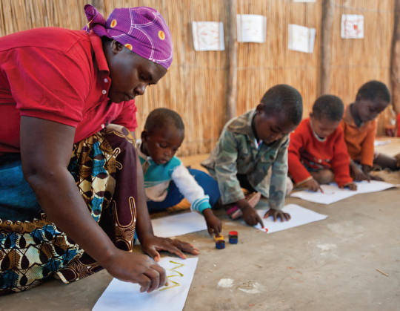
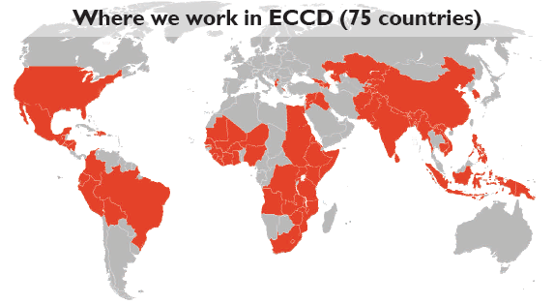
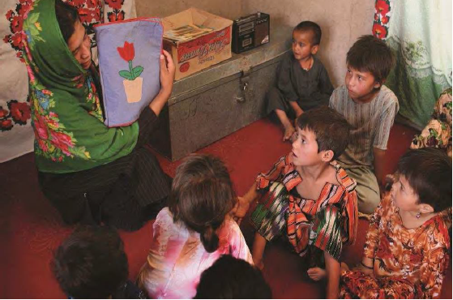
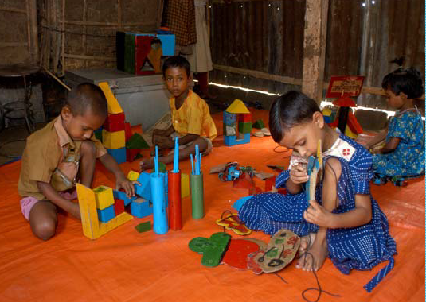
ECD Delivery Modalities
Community based ECCD
0-3 Parent support
Home based ECCD
School based ECCD
Notes:
Complex task – how do we ensure quality and how do we keep improving our programs?
We are very serious about ensuring quality and about measuring it-

Slide 3
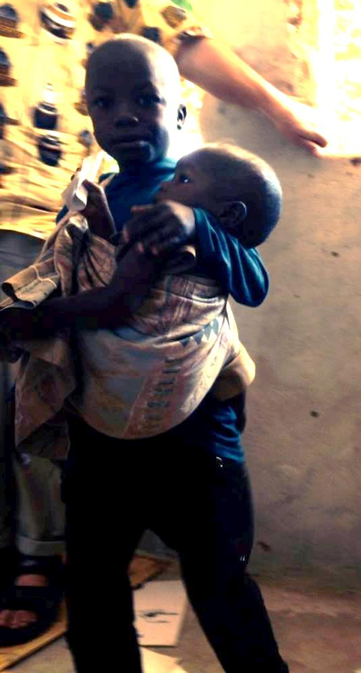
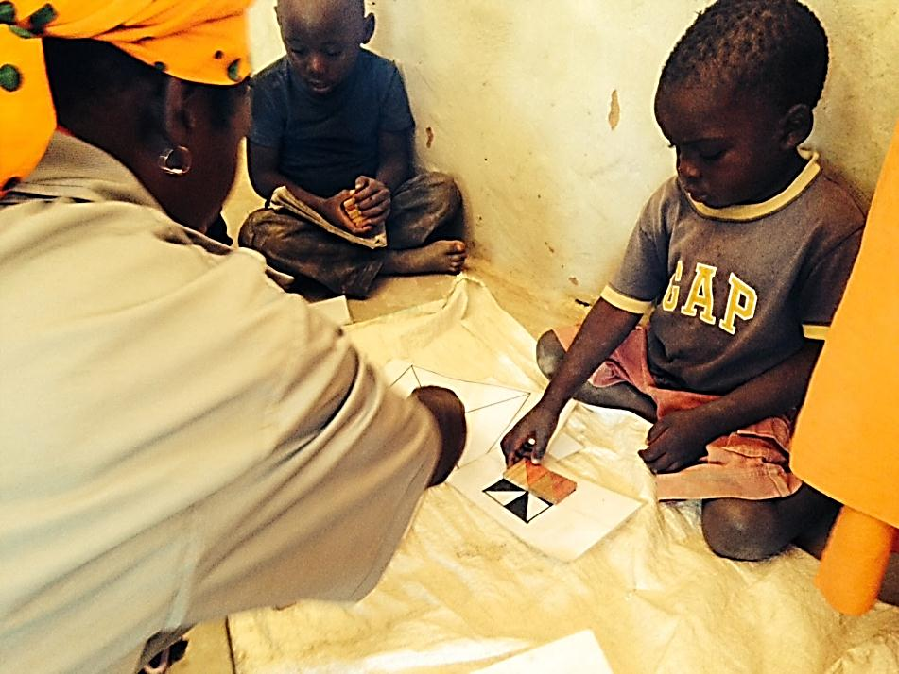
WHAT IS VULNERABILITY?
Notes:
4.5 million children under the age of 5
4% preschool enrollment in 2012 – mostly affluent urban population
Children are in different situations. Some children have little support for learning and development in the early years. Especially if parents or caregivers are focused on subsistence and survival, then we know children are going to be more vulnerable. Some children may have access to ECD services but are still bringing vulnerabilities with them into ECD programs, whereas others in the same program may be less at-risk in terms of their development.

Slide 4
Mozambique - $30 per child per year
87% increase in the cognitive domain scores; strong results motor and emotional development
24% more likely to enroll in primary school
7.2 additional hours/wk on learning activities
Language development
40% stunting

Slide 5
Results for Families
Caregivers 37% more likely to work
Instances of physical punishment – 46% drop vs. control
6% increase 10-15 year-olds going to school

Slide 6
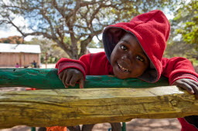
Community Preschool Model – Implementation Vulnerabilities
Community management committee – training + exchanges + microcredit
Volunteer teachers: training + learning circles
Quality stimulation, psychosocial support, emergent literacy
Improved parenting practices
Facilitate transition to primary
Attendance & Participation
Community Contribution
Engagement of primary schools
Monthly parent meetings
Accessibility of Other Services
Quality of Learning Environment & Development
Infrastructure: materials, playground, latrine, handwashing
Linkage to Gov. health services
Notes:
Turned into a Basic Service Package in contracts with service providers including Save the Children

Slide 7
Balancing Vulnerability at Scale and Potential Impact: Criteria for Selection
% 6-yr-olds not in Grade 1– up to 60%
Prevalence of malnutrition – up to 56%
Lack of access to safe water sources and sanitation– as low as 29%
Number of children under 5
Notes:
Start with Educational Outcomes
Look at underlying causes
Look at availability of basic services
Look at reach
Consider the capacity and motivation to take it up

Slide 8
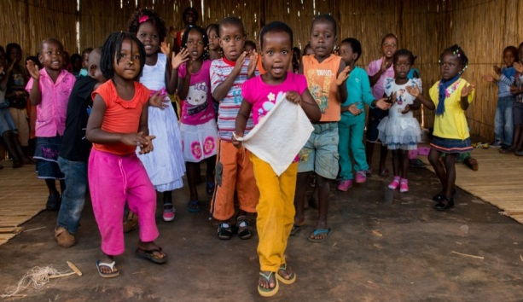
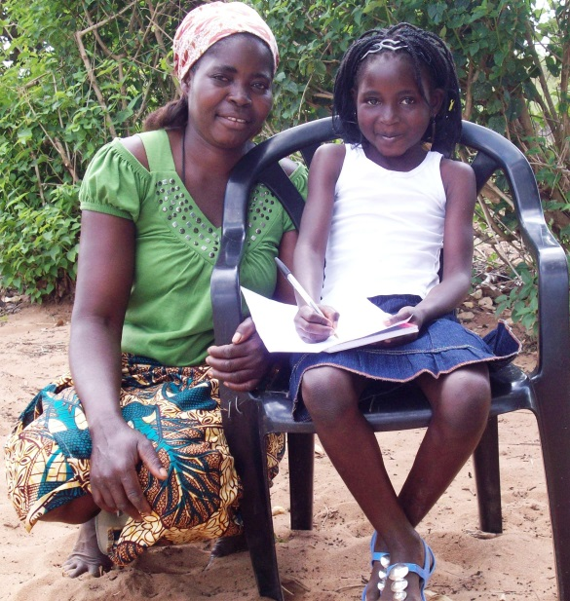
Costs: from community ECD to ECD systems
2008: 30 ECD centers + RCT
$40 million investment
Expand preschool and parent education reach to 84,000 children
Pre-primary in Education Plan
Expand access to quality ECD + build foundations for national ECD system
$172-262 per child per year
Notes:
How much will this reduce vulnerability? Research indicates that impact can be large in terms of child development foundations with strong impact likely on education system. Parallel efforts to address underlying causes and weak systems would be needed to address other vulnerabilities. Will the building of the system allow for equity in outcomes?

Slide 9
Vulnerable home environments and impact on child development outcomes
Notes:
Consistency of gap
These are gaps at baseline – that is the gaps that children are coming to centers with – and we’ve all seen the inequality chart that show these gaps at young ages widening as children get older. This 4+ benchmark comes from UNICEF’s MICS assessment.
We know from LB research that home learning environments are impacting children’s learning above and beyond other equity factors like SES and gender so we are continuing that focus down to younger ages to continue understanding this relationship and highlighting the importance of our work with parents.
Socio-emotional development seems to be most heavily impacted by gaps in equity related to home learning.

Slide 10
Vulnerability – in program access & impact Expandable to disadvantaged, mobile, pastoralist? Pilot at $91/per child/year

Slide 11
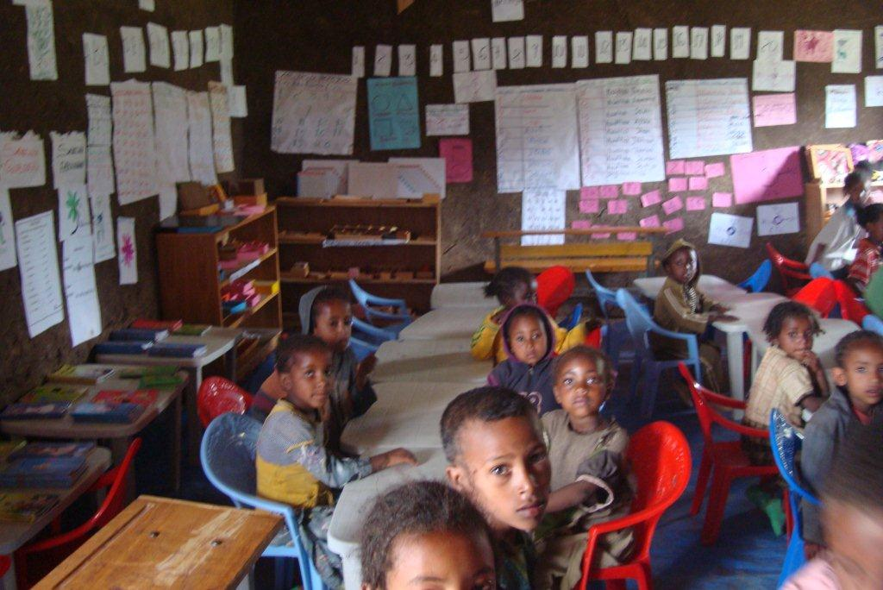
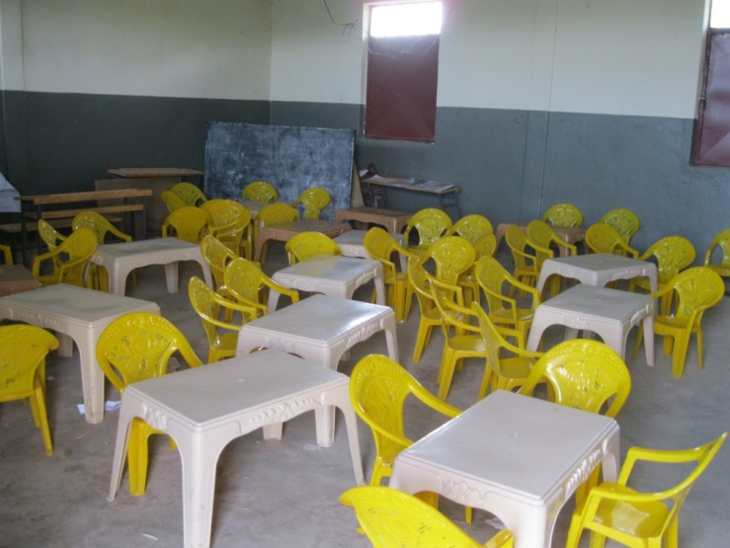
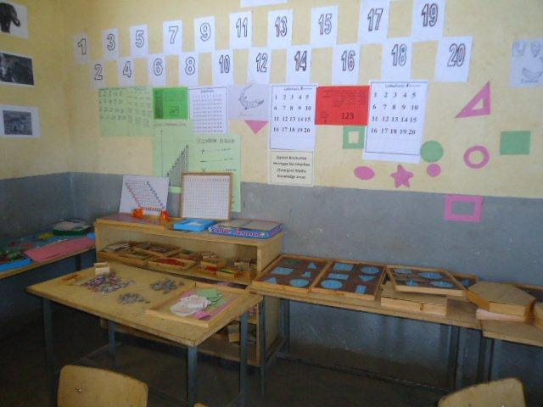
Intentional quality to improve equity – Add on $10-15 dollars per center year in Ethiopia

Slide 12
Closing the gap within quality ECD
Notes:
Closing the gap: The poorest children in Ethiopia began the year with significantly lower average language scores than their better off counterparts, and gained significantly more: 47 percentage points, while the best off group gained only 40 percentage points.

Slide 13
Questions?
Vulnerabilities in:
Program Targeting
Systems
Need for families to seek services
Home Environments
Transaction with Caregiver/Teacher
Do program assumptions take into consideration hidden costs of what is the expected contribution of families and communities?
How do we include the minimum threshold of equity and quality in costing?

Slide 14
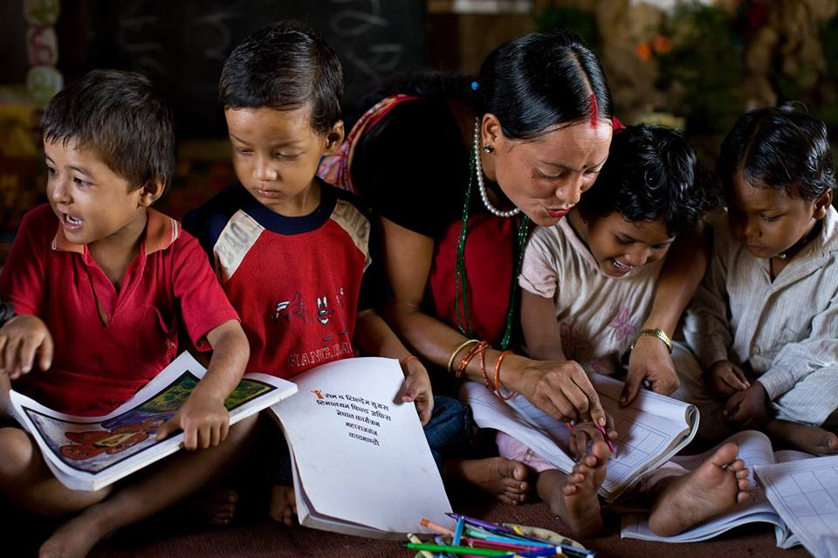
Thank you
spoehlman@savechildren.org

