Slide 1
International Development and Early Learning Assessment
Lauren Pisani, Save the Children
Notes:
Not sure about the title…

Slide 2
Outline
Tool Development
Tool Overview
Tool Use
Lessons Learned
Discussion
Notes:
Instructions on how to replace pictures in circle smart art:
Delete existing placeholder photo.
Double click on photo icon in gray background to open up dialog box.
Browse computer for image you’re looking for.
Select image, double click and your photo should populate into the selected circle (s).
NOTE: The steps are the same for inputting images via smart art in both WORD and PPT

Slide 3
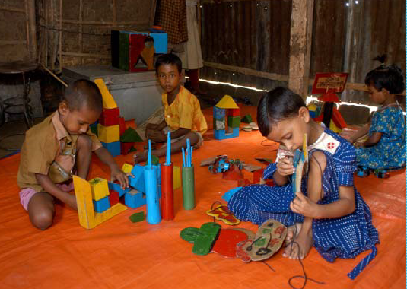
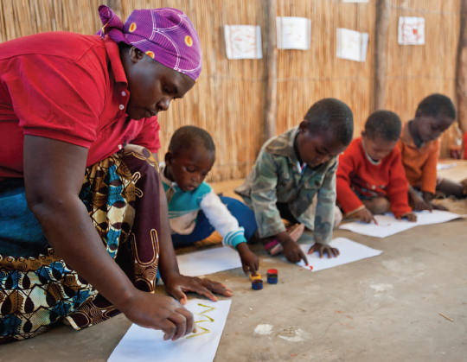
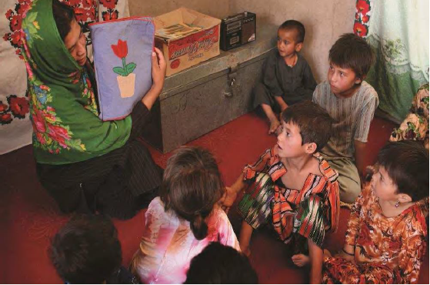
Save the Children’s Global ECCD Portfolio
Work in over 75 countries around the globe
Directly reach close to 2 million children per year and indirectly touch the lives of over 10 million children
Support a wide range of programs – Home/Community/School based, Parent Education, Intensive Summer Programs, and more
Notes:
SC has a broad ECD portfolio that supports a wide range of ECCD programs – from traditional center-based to alternative approaches like parenting education and intensive summer programs.

Slide 4
Why measure early learning & development ?
Accountability to communities and donors
Continuous program Improvement
Increased national focus and advocacy for ECCD
Cross-country comparability and global attention
Notes:
Across these diverse programs, we wanted a common measure of what works so that we could be evidence driven in our decisions to adopt (or not) certain approaches.
So our primary purpose for developing the tool was accountability to the communities we support as well as donors. Relatedly, we’re found that IDELA is also very useful continuous program improvement. And now that we’re using the tool across so many countries we’re seeing the benefits of having cross-country comparability – mostly for program comparison purposes - and also for using as an advocacy tool with governments and other partners. THe goverments of both Mali and Bhutan are talking about supporting ECD at scale due to IDELA.

Slide 5
International Development and Early Learning Assessment (IDELA): 3 Pillars
IDELA
Useful for programs
Globally applicable
Rigorous
Notes:
IDELA seeks balance across three key dimensions:
Useful for programs – proving information that can be used by programs to improve outcomes for children
Globally applicable – built on ECD standards and core child development competencies recognized around the world; using questions that can be easily adapted to meet local contexts. Also something that can be used in low-resource contexts without an enormous research budget or an army of trained specialists to administer it
Rigorous – reliably measuring the child development domains we aim to measure. We now have both internal and external reports validating the rigor of the tool – can share if anyone is interested.

Slide 6
What is IDELA?
Direct child assessment
Intended for global use, feasible in low income countries
Successfully adapted and used in varied contexts, 30+ countries to date
Intended to improve programs, policy, and practice and inspire investment
Monitors/tracks progress on a population/community level
Tracks impact of interventions; compares effectiveness of approaches
Notes:
Just to re-iterate a few key points

Slide 7
What is IDELA not?
High stakes school readiness test
Individual child diagnostic assessment
Formative assessment
Ready for any use; off the shelf instrument
Notes:
Data is reported in aggregate; we’re not making decisions about individual children with this assessment. Also local adaptation is key so it’s not an ‘off the shelf’ assessment

Slide 8
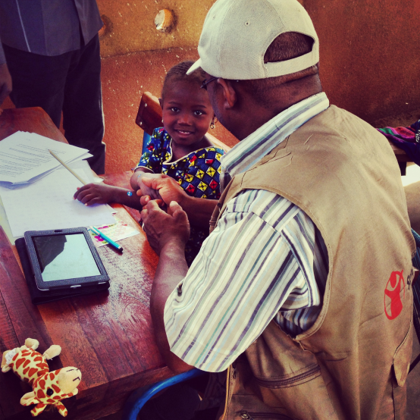
IDELA Overview
Play-based assessment tool designed for children in the 3-6 age group
Takes about 30 minutes per child
Includes 22 core items that cover 4 developmental domains + learning approaches and aspects of executive function
Emphasizes continuous scoring over yes/no responses
Available in English, Spanish, French, Arabic, and many other languages
Notes:
The notes seem like they are quite curious about how IDELA looks in the field so you probably want to explain each of these points in detail

Slide 9
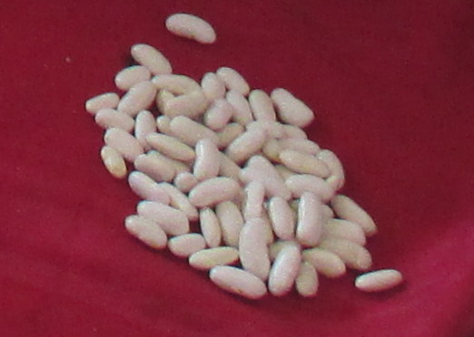
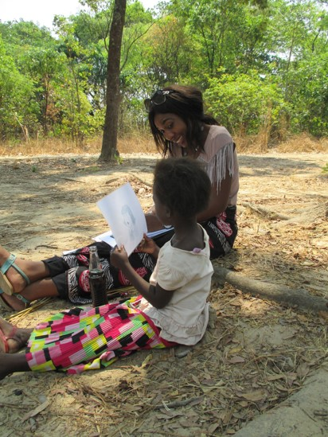
Simple adaptation and administration across settings
Minimal administration materials
Children’s book, pencil, paper, and small objects for counting, 8 picture cards
Adaptation of materials and items is important part of the process of introducing the tool to new sites
Administration, adaptation and training manuals standardize the use of the tool across sites
Assessors do not need to be child development experts
Tablets or paper & pencil can be used
Notes:
The level of people who have administered tis of a community worker type profile; it can also can be administered by ECD teachers
- Promising practice, advocacy with national governments, direct investment to most needed areas

Slide 10
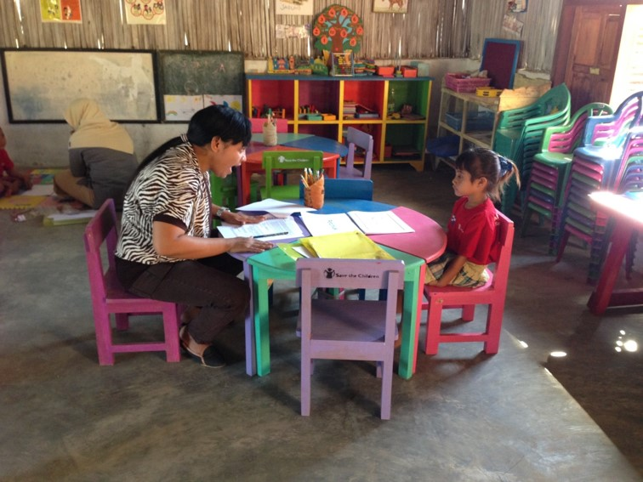
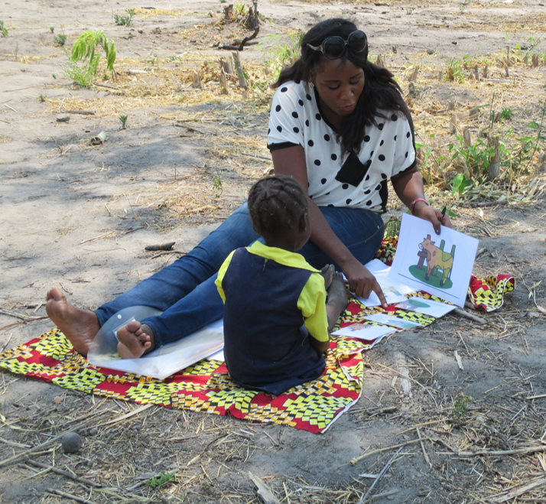
Simple adaptation and administration across settings
Notes:
The level of people who have administered tis of a community worker type profile; it can also can be administered by ECD teachers
- Promising practice, advocacy with national governments, direct investment to most needed areas

Slide 11
IDELA Domains & Skills
Motor Development
Print awareness; Expressive vocabulary; Letters; Phonological awareness; Listening comprehension
Emergent Math/ Numeracy
Social-Emotional Development
Empathy; Emotional awareness; Self awareness; Solving conflict; Peer relationships
Fine and gross motor skills: Hopping; Copying shape; Folding paper; Drawing
Number sense; Shapes; Sorting; Problem Solving; Comparison; Simple operations
Emergent Language and Literacy
Learning Approaches
Executive Function
Notes:
EF items are option and listed in the middle here because these items assess things like working memory and attention which are skills that underlie the other more academic domains
Learning approaches in an assessor reported observation of children’s approach to new and complicated problems during the assessment

Slide 12
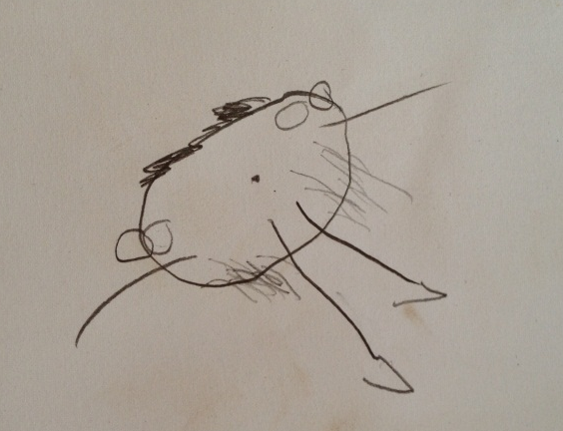
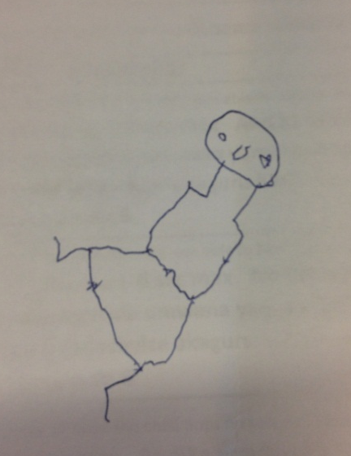
Sample Question: Fine Motor Development
Give the pencil and paper to the child and say “I have another drawing game for you. Please draw a picture of a girl or a boy standing up.”
 | Correct | Incorrect/ Do not know | Refused/ Skipped
Child draws a head | 1 | 0 | 999
Child draws a trunk/body | 1 | 0 | 999
Child draws arms | 1 | 0 | 999
Child draws legs | 1 | 0 | 999
Child draws 1 facial feature | 1 | 0 | 999
Child draws 2 facial feature | 1 | 0 | 999
Child draws hands | 1 | 0 | 999
Child draws feet | 1 | 0 | 999
Notes:
Let me give you a sense of what the items and questions look like:
And then we look for the level of detail and “fine motor” control the child had in drawing the person- one of the strongest areas of the IDELA is the scoring- which allows for a more nuanced perspective on learning and development- so we are not scoring if the child drew a person with all recognizable features for example – but score in a continuous fashion
•Item reliable and accurate; technically sound
•Emphasis on “teachable” and “actionable” items

Slide 13
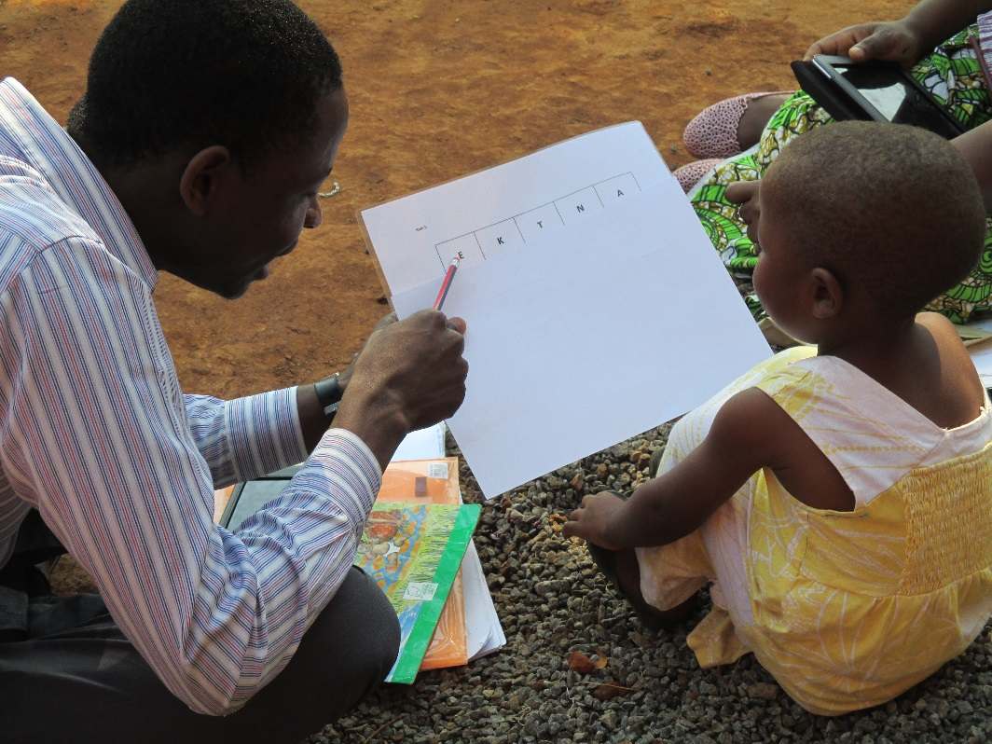
Sample Question: Emergent Literacy – Letter identification
What letter is this?
Total number of letters child named | /20

Slide 14
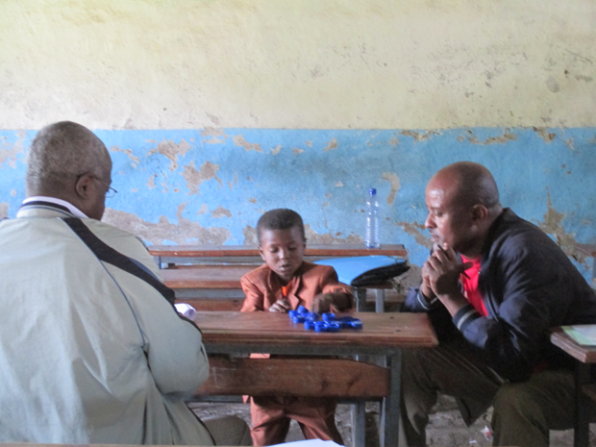
Sample Question: Emergent Math - One-to-One Correspondence
Materials: 20 small items (e.g. stones/blocks/beans etc.)
Now we are going to play with bottle caps. Here are some bottle caps. Can you please give me 3?
Re-arrange the 20 bottle caps randomly again and say:
Thanks. Now, can you please give me 7 bottle caps?
If the child cannot give you 3 or 7 objects, stop and move on to the next item.
Can you please give me 15 bottle caps?

Slide 15
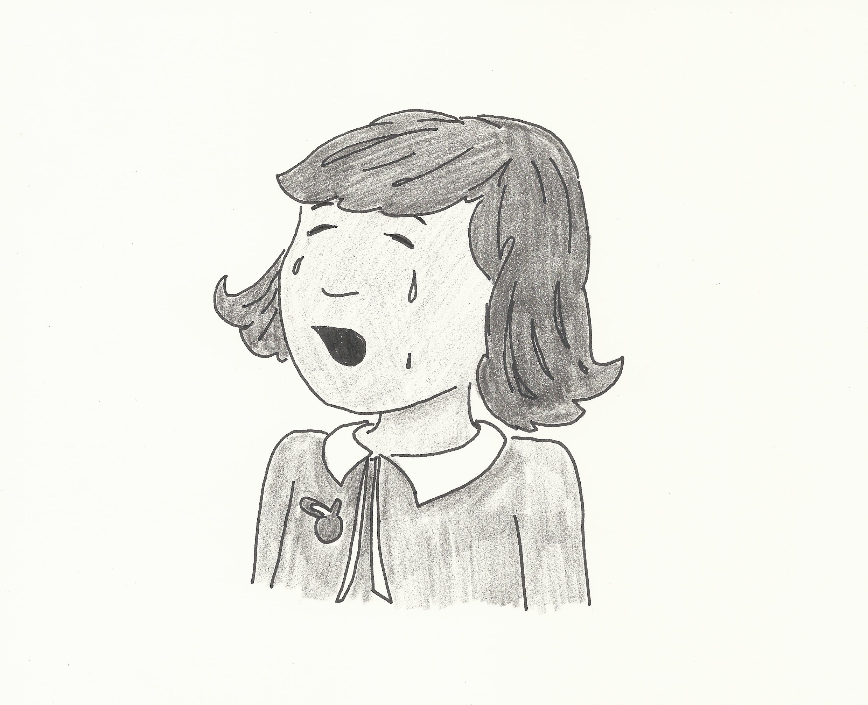
Sample Question: Social-Emotional Development
Perspective Taking/Empathy
Materials: Picture card of a girl crying
Show the picture card and say,
Now let’s look at this picture. How do you think this child is feeling right now?
Then ask, What would you do to help her feel better?
Prompt ONCE by asking, Is there anything else you would do to make her feel better?
[
Notes:
Acceptable answers
Child crying – Scared, painful, sad, feels like crying or other culturally acceptable answer
Helps in distress – asks an adult for help, hug her, play with him or any acceptable answer

Slide 16
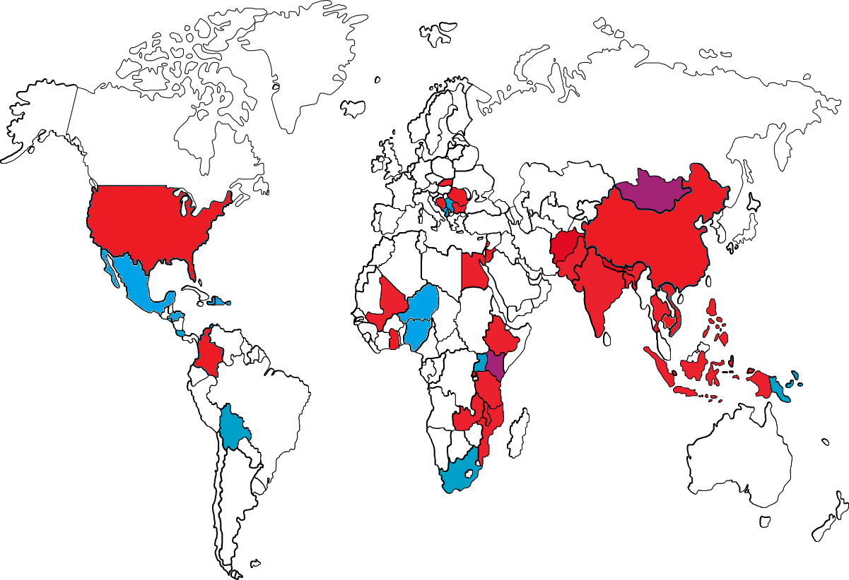
IDELA Globally
IDELA Used
IDELA Planned
MELQO Partnership
Notes:
IDELA is currently in 30 countries and counting

Slide 17
IDELA can be used alone or with other tools
Child development (IDELA)
Caregiver support
Program quality
Notes:
IDELA gives us key information about child development that up to now has been largely unavailable to programs like ours but in many of our studies we also include tools that capture information about the environment within which children are developing – at home is the most common and then program or classroom quality where possible.
We have a template for the caregiver questionnaire a have a tried a few classroom quality tools that we could recommend but nothing standard in the ‘package’ yet.

Slide 18
IDELA Use: Accountability
Notes:
Examples of IDELA use: First, for program accountability – Standard ECD is gov’t supported; high quality is SC’s ELM (Early literacy and math) program

Slide 19
IDELA Use: Accountability
Notes:
Same evaluation and we found that not only was the program effective but it was also equitable. At baseline children form the richest families had the highest scores but over the course of the program the poorer children caught up and all children were at the same level.

Slide 20
IDELA Use: Continuous program improvement
Scribbling
Drawing controlled shapes
Writing letters
Writing sentences
Notes:
A big focus for SC recently has been transition into grade 1 and how we can better support kids on the first day of their first year in school. We know that children learn continuously but ECD and BE are often treated like two totally separate entities. IDELA has been a great entry point for us to have that discussion with both ECD and BE groups – It allows us to ask both are children ready to entry primary school and are schools ready to accept children with the abilities that they have?

Slide 21
IDELA Use: Continuous program improvement
Notes:
A baseline study of children’s skills in Vietnam found that children from minority groups were entering ECD centers with significantly weaker skills than their non-minority peers. Differences were especially pronounced in emergent literacy where IDELA scores suggest that minority children have very weak oral comprehension skills, which has serious implications for their success in a majority-language classroom. The program team is now working through strategies for tackling this issue.

Slide 22
IDELA Use: Continuous program improvement
Notes:
In another scenario, Bhutan’s national ECD study using IDELA found that the amount of learningand play activities happening in children’s home was one of the strongest drivers of their early learning skills. Their programming had been largely center-based but they are now pursuing both center and home-based interventions to address this issue, especially given that most children in the country do not have access to ECD centers so parents are their first and only teachers until they get to primary school.

Slide 23
IDELA Use: National attention and advocacy
Bhutan
National ECCD study led by SC and involving MoE, UNICEF, and all local NGOs
Incorporated IDELA into national ECCD plan to build evidence, build capacity, learn from example, identify strategic entry point, develop a strategy for solutions in the national plan, an mobilize stakeholders
Mali
Results of study will inform the government’s way forward for bringing quality ECD programs to scale
Notes:
Through using IDELA across countries we have seen that there are big equity issues in ECD in terms of access

Slide 24
IDELA Use: Cross-country comparability and global attention
Global (MELQO)
Brookings Institution, UNICEF, UNESCO, World Bank
World Bank
Slovakia, Bulgaria, Romania,
Budapest – 12 country training to get comparative outcomes
Universities
New York University (psychometric analysis & Ghana),
Aga Khan University (Pakistan),
Yale University (Colombia),
UniNorte (Colombia),
University of Zambia
Technical Providers
Roma Education Fund (Balkan Region)
Ubongo (Tanzania),
RTI (Kenya),
AIR (Bangladesh),
EQUIP (Tanzania),
IECD for Young Children Affected by HIV and AIDS (Kenya),
International Rescue Committee (Lebanon)
Tembo (Nigeria)
FSG (India)
Notes:
These are all the partners we have to date and the list keeps growing. Most exciting has been the recent infusion of money from OSF to build an IDELA website and knowledge hub. We will start building in 2016 and launch in 2017
Look out for some exciting news about a new possible partnership for an IDELA website coming soon!

Slide 25
Lessons learned from IDELA
The most vulnerable children are not in preschool
Working outside of center-based programs can reach the most vulnerable and also produce strong learning gains for children
Disparities in learning start early and are highly correlated to activities at home
Studies in multiple countries have shown that children with the weakest skills are those without access to center-based programs
High-quality parenting programs can significantly improve children’s learning and development
Parents are children’s first teachers and home learning environment is consistently related to children’s early skills
Notes:
These are a few snapshots of things SC has learned from IDELA use across our programs

Slide 26
Discussion

Slide 27
Thank you!
lpisani@savechildren.org

