Slide 1
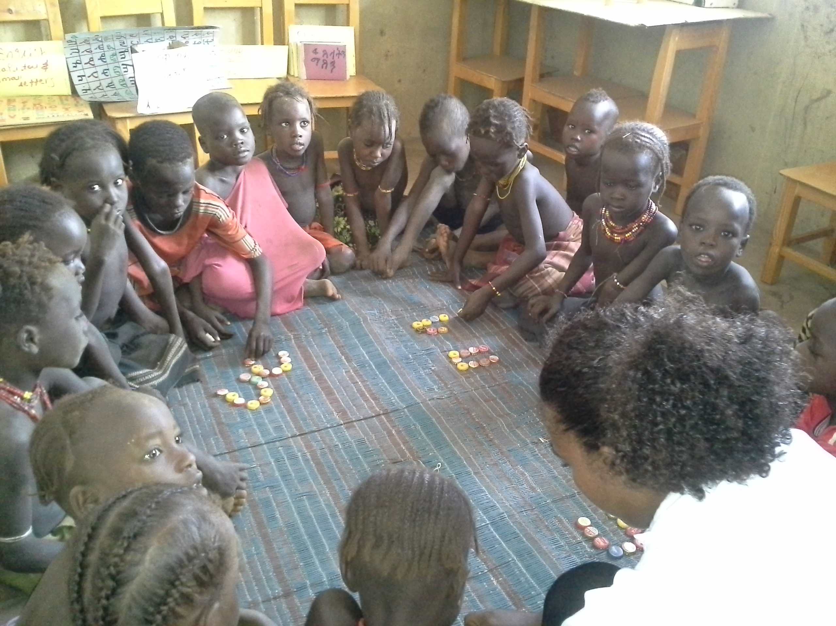
Demonstration & practice with parents: a key to enhancing child development outcomes
Enhancing O Class Quality
for Greater Learning Outcomes
Katy Anis
Save the Children

Slide 2



How Do
Humans Learn?

Slide 3
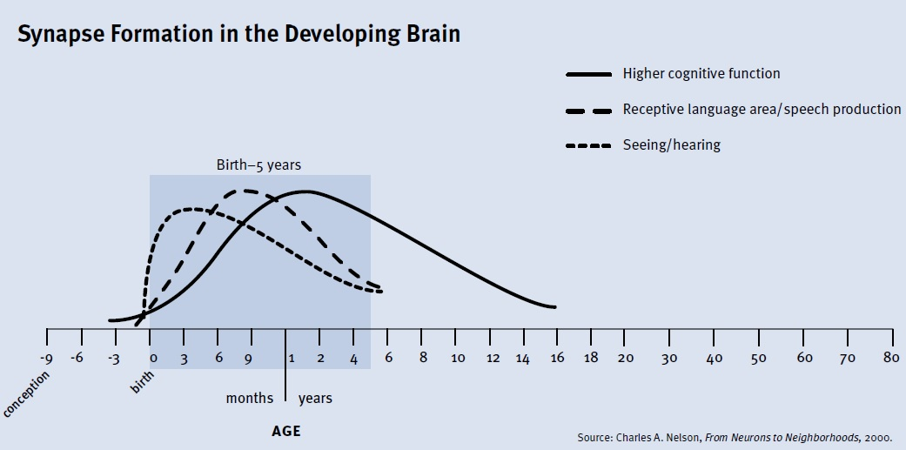
B. Key Facts about Brain Growth & Development
Sensitive & Critical Period for Development
Notes:
-Early experiences matter as brain development/growth is most rapid and vulnerable from conception to age 5. (80% in the first 3 years; 90% peak by age 5 or 6)
-Interventions can have lasting effects during this period.
-The neuroplasticity of the brain decreases with increasing maturity. (National Research Council Institute of Medicine, 2002)
-Age 1 to 3 as sensitive periods for brain’s development of language. After age 6 to 7, children’s resiliency to recover from trauma in the area of language plummets. (Eliot, 2000)
-By the age of 6 to 7, a child’s neurological architecture has already been sculpted. (Eliot, 2000; Shonkoff and Phillips, 2000).
-The larger the multiplicity of risk factors, the more severe the impact on children’s resilience. (World Bank, 2012)

Slide 4
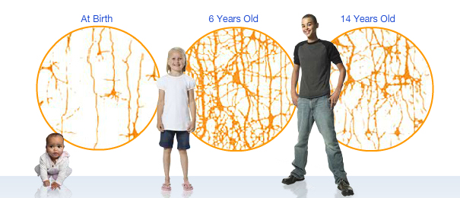
Early Experience and Early Exposure to Learning
Windows of opportunity in the developing brain
After birth, a child’s brain starts to connect cells (neurons) into simple circuits which build on more complex circuits (development of motor control, language, etc.) Experiences and interactions between child and care provider strengthen these connections (Schiller, 2010).
A baby’s brain is growing 500,000 neurons per minute. 15,000 synapses are created on every cortical neuron, at the speed of 1.8 million new synapses per second between 2 months after conception until 2 years after birth (Eliot, 1999).
Following this peak, children lose up to 20 billion synapses per day between early childhood and adolescence, when these synapses are not stimulated (Eliot, 1999).
Source: The Australian Early Development Index
Notes:
Schiller, Pam . "Early brain development research review and update." Exchange Magazine: Brain Development Nov/Dec (2010): 26-29
Early Caregiver interactions can shape them in positive, productive ways or negative ways through neglect or abuse.

Slide 5
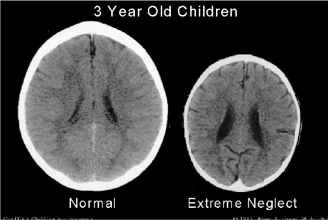
What is the Impact of Early Learning
Brains and Skills are Shaped by the “Serve and Return” Nature of Human Interaction, which happens first with caregivers
Children ask an average of between 50-150 questions per hour by age 4. This could equate to 220,000-660,000 questions by age 4, before most children ever enter a formal learning institution.
In terms of effects of actual brain anatomy, the brain has 6 % more surface area among those who grow up in better social and economic circumstances and higher parental level of education.
Social economic status and sensory deprivation affects brain size and thickness
Notes:
WHAT IS THE IMPACT OF PARENTAL LEARNING
No matter how much effort we place on quality education, the school environment constitutes only small fraction of children’s days and the bulk of their time is still spent at home. If these homes are supportive of children's learning and dev’t, if caregivers have the skills and confidence to extend learning at home undoubtedly the results we would see for children will be greater than if these homes were devoid of support for learning and if caregivers didn’t see their role as a teachers
-research that shows actual brain anatomy , the size of the brain has 6 % more surface area
What are the factors?
Socio econ- no surise
Parental education
Most of have heard that children from higher socio-economic status have heard more than 30 million words by age 4. ( cite the research)
Catherine Snow talks about this being more than “word gap” but a knowledge gap.
In one study- least talkative child asked 50 questions per hour, most talkative child asked 150 question per hour. These are opportunities to learn.
That could be a total of 220,000- 660,000 questions at reaching age 4. Be they answered or unaswered
Children come into first grade with a knowledge base, based on their environment has responded to them, be it rich or poor
he Thirty Million Word Gap
Hart, B., & Risley, T.R. (1995). Meaningful differences in the everyday experience of young American children. Paul H. Brookes Publishing Co.
The Thirty Million Words Initiative (Links to an external site.)

Slide 6
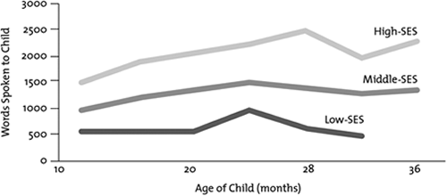
Early Language Stimulation
Vocabulary growth in the first 3 years
Source: Hart & Risley. Meaningful Differences in Everyday Experiences of Young American Children, 1995.
Notes:
-Oral language skills developed in responsive environments (i.e. interactions between children and caregivers) have considerable impact on future reading development.
-Differences in development appear very early
-Disparities in vocabulary between children in low SE hseholds and high SES begin as early as 18 months and widens – as children enter school.
-Amount of parental talk and language interactions is highly associated with vocabulary size in the early years.
-By age 3, children from wealthier families (who received more language inputs) have vocabs 2-3 times larger than their disadvantaged peers.
!!! Early oral language skills (before age 3) could predict differences in vocab size/reading comprehension scores at age 9, controlling other factors.

Slide 7
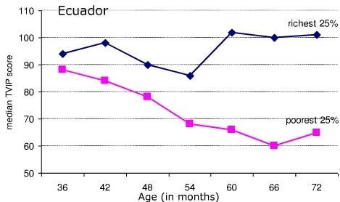
Vocabulary difference by age 6 in Ecuador
By 6 years old, children show marked cognitive differences.
Source: Adapted from Paxson and Schady (2007)
Source: Hart & Risley. Meaningful Differences in Everyday Experiences of Young American Children, 1995.
Notes:
-Early inputs follow kids. If a child enters school with 6,000 or 13,000 vocabulary words, this early start follows the child through life.
-Longitudinal research demonstrates that:
-ability to pay attention and complete a task at age 4 has greater correlation with college completion at age 25 than any academic attainment in the intervening years, (McClelland, Acocka, Piccininb, Rheac, 2012)
-And that a child’s learning and reading skills in kindergarten predicts grade 6 reading and math levels (McClelland et al., 2006, 2000).

Slide 8
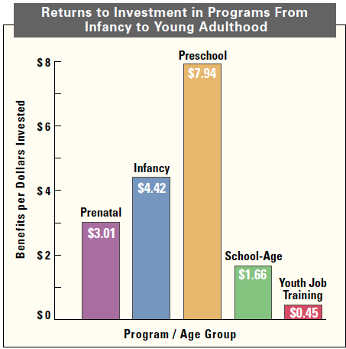
The Rationale for Investment in Early Learning
ECD interventions are one of the most cost-effective investments a nation can make to create rich human capital and development.
Research has shown for every dollar spent on pre-school programs, there is a $7 – $8 return to individuals and society. (Carniero & Heckman, 2003)
Even prenatal programming has a higher rate of return than investing in kids at school age. (Carniero & Heckman, 2003)
Effective Early Childhood Programs: Turning
Knowledge Into Action Landry, 2005
Notes:
Heckman, J. J., S. H. Moon, R. Pinto, P. A. Savalyev, and A. Yavitz. 2009. “The Rate of Return to the High/Scope Perry Preschool Program.” Unpublished manuscript, Department of Economics, University of Chicago.

Slide 9
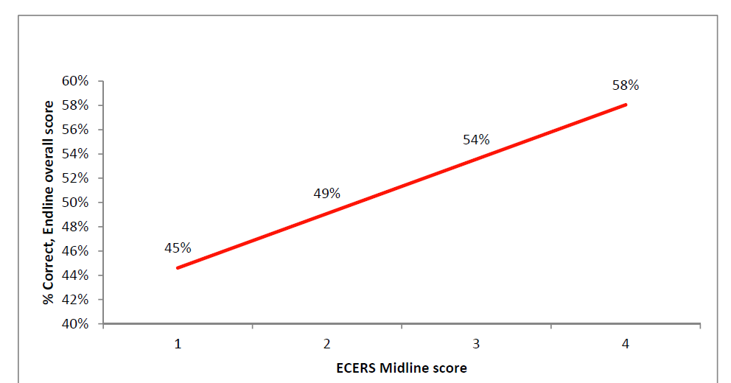
Quality Matters
Build on quality ECCD principles first! –
O Class is not Grade 1 for little kids!
Rwanda ECERS Midline scores predict learning gains from midline to endline in ECCD centers implementing Emergent Literacy and Math

Slide 10
Links between Home Environment and Child Outcomes

Slide 11
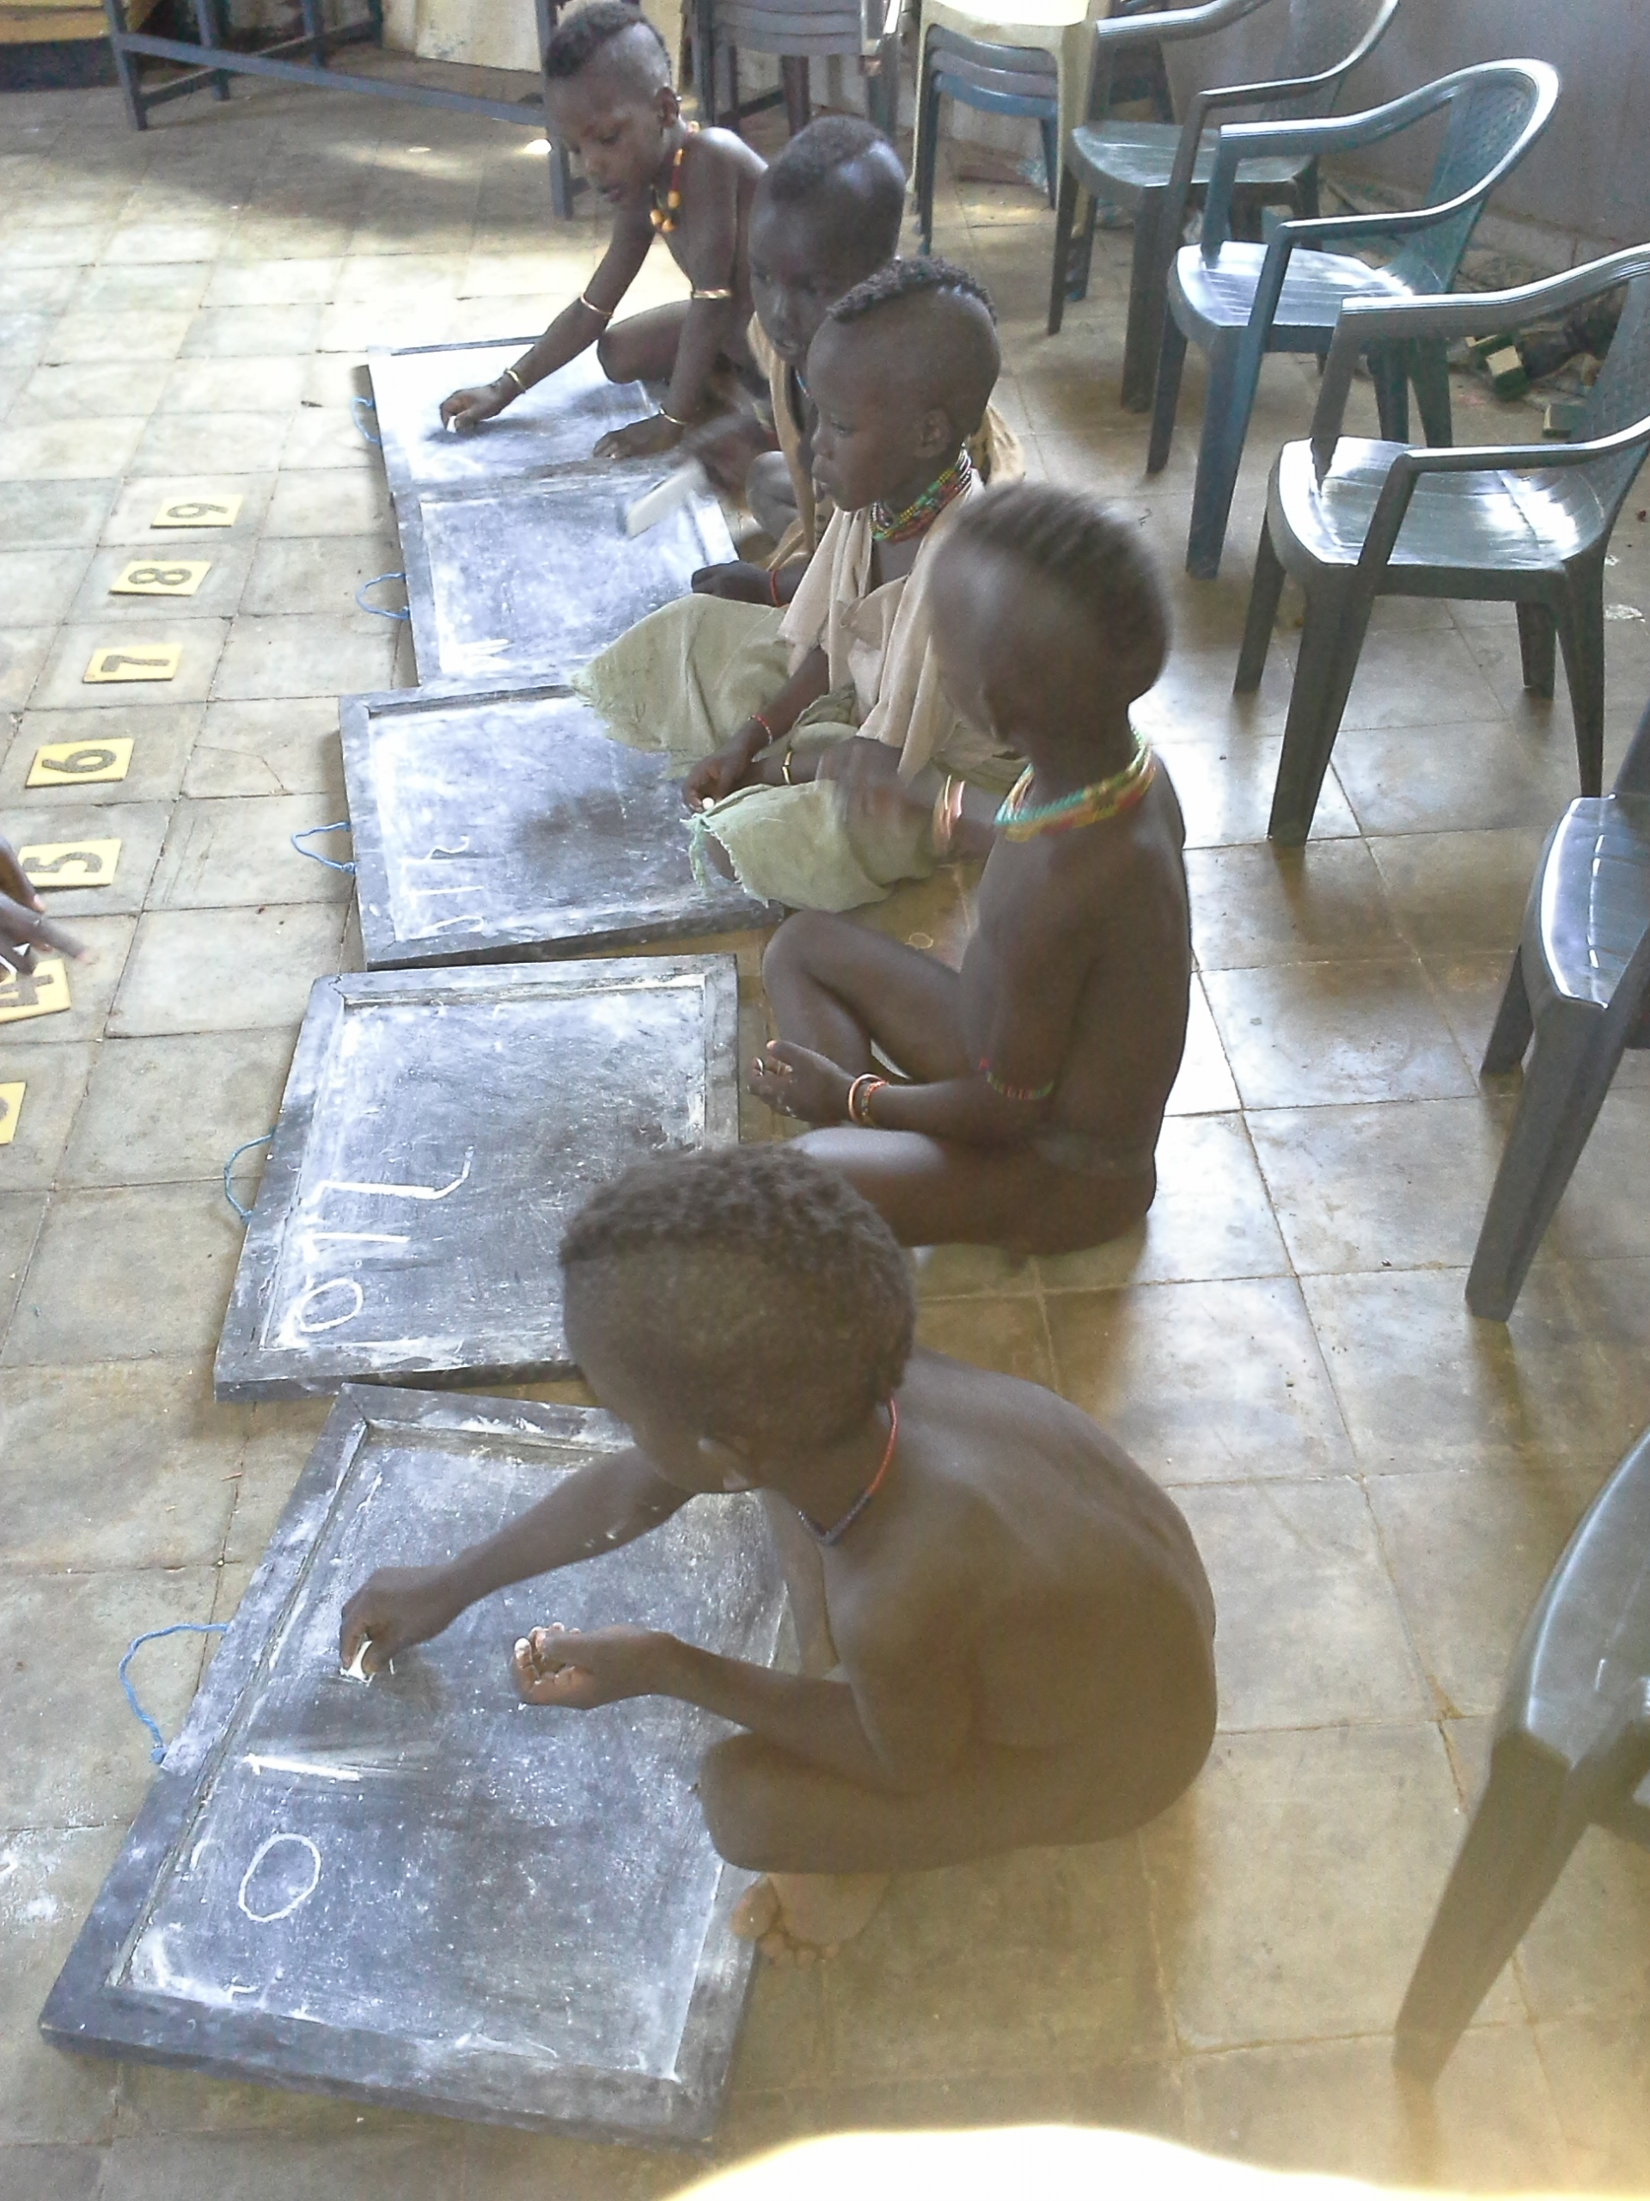
Infrastructure vs. Teaching and Learning
In the Colombia experience, the government invested huge amounts in sturdy structures for ECCD. But little attention to investment in quality. Learning outcomes were dismal, and the experience was declared a failure.
In Ecuador, one study followed early grade children who were randomly assigned three bad teachers, three years in a row. Another group was assigned, three good teachers, three years in a row. The results in learning outcomes were striking!
The Early Years, 2015, IDB
Hammer children
practicing literacy

Slide 12
Ethiopia- Programming in ECCD
Evolving since 1999…….
Notes:
Ethiopia implements ELM in four different sites

Slide 13
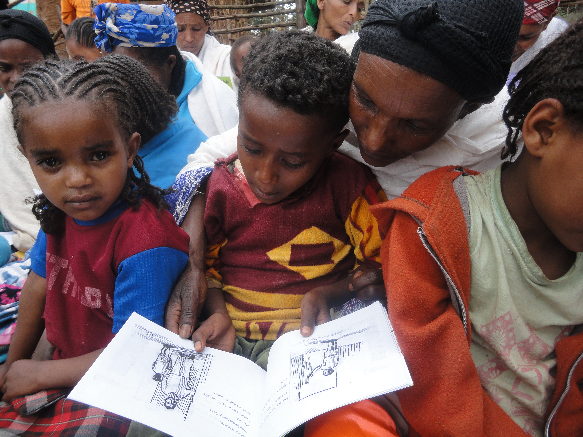
Save’s Support to ECCD in Ethiopia
AFAR: 6 ECCD centers
SNNPR: 16 ECCD centers and 6 O classes in South Omo
TIGRAY: 17 ECCD Centers and 58 O classes
OROMIA: 46 ECCD centers and 77 government regular ‘O’ classes
BENISHANGUL GUMUZ- 4 alternative ECD sites in emergency situation
GAMBELLA- 19 alternative ECD sites in emergency situation
SOMALI - 5 alternative ECD sites in emergency situation
Total Children Reached: 60,892

Slide 14
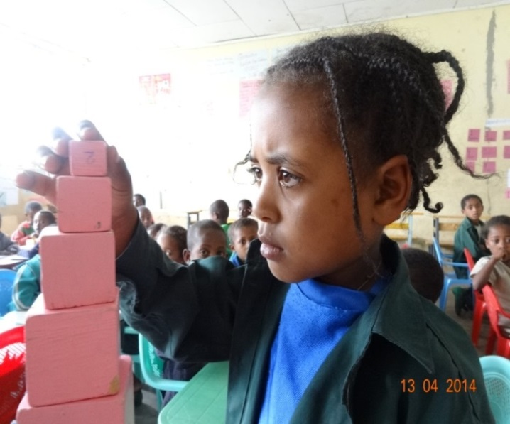

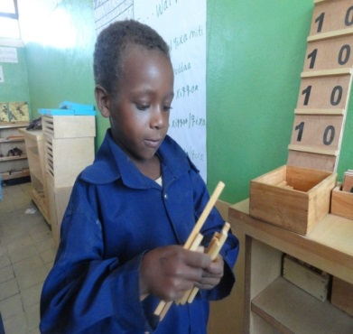
Save’s ECCD Support Strategies
Training teachers in foundational early child development and emergent literacy and math
Provision of indoor learning materials and outdoor play materials
Collaborating closely with primary schools
Parent and caregiver work focuses on: Emergent Literacy and Math, Child Development and Improving Caregiver practices and behavior
Access, quality enhancement, capacity strengthening, policy support and advocacy
Continuous assessment
Support to alternative ECD in emergencies.
Occasional renovation to O classes or construction of ECCD Centers when resources available

Slide 15
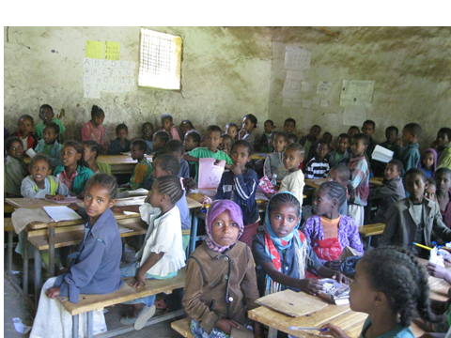
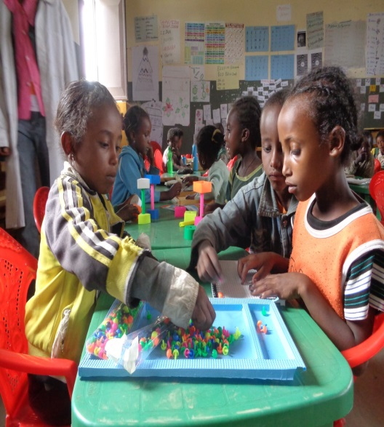
Continuous Focus on Quality
Continuous capacity strengthening activities
Consistent monitoring and coaching in the classroom
Regular assessment of child outcomes and quality
  using the IDELA tool (International Development and Early Learning Assessment)
  Using the Quality Learning Environment and ECERS (Early Childhood Environment Scale) tools.
Ongoing parents engagement in training and in classroom support
‘O’ Class Before
‘O’ Class After

Slide 16

Training for ECCD Facilitators
Paraprofessionals, grade 10 completers
Selected by community representatives and district education offices
Hired by community
Provided Basic pre-service training for 3 months (summer block course) at private institute
Focuses on Minimum Learning Competency-Developed by Federal MoE, collaborating with TTC Content
Provided continuous in-service trainings on Emergent Literacy and Math(ELM) toolkit, center organization, activity preparation and management, children engagement and discipline, material production

Slide 17
Curriculum for Training Facilitators in Early Child Development
No. | Type of Courses | Cr.Hr
1 | Pedagogical Science | 3
2 | Child Psychology | 2
3 | Philosophy of teaching young children | 2
4 | special Need/Inclusive Education | 2
5 | English Language | 3
6 | Classroom Management | 2
7 | Health and Nutrition | 3
8 | Practical life Activities | 2
9 | Sensorial Activities | 2
10 | Language Activities | 2
11 | mathematics Activities | 2
12 | Culture Activities(1crhr), Play, Music and Art | 2
13 | Material Production | 2
14 | Peer teaching(2 crhrs) | 2
 | Total | 31

Slide 18
Emergent Literacy and Math (ELM) Toolkit
Preschool: Educators Training Toolkit
3 flexible modules (pre or in-service teacher training)
An activity bank with100+ early literacy & math games
Home: Parent Education Toolkit
8 sessions
25 + games
Books & Math
Manipulatives
3. Provide ample access to children’s books and math materials
Boost the focus on language and early math in preschools, integrated in any curriculum
Change parents’ attitudes and increase skills to support children’s learning at home
Notes:
Our response was a quality enhancement toolkit focused on strengthening foundational early literacy and math skills
What makes this toolkit unique
Practical nature of the materials
The dual foci
The simplicity of implementation
The focus on ELM which makes it easy to integrate and birng into other teacher trainig or parent education packages

Slide 19
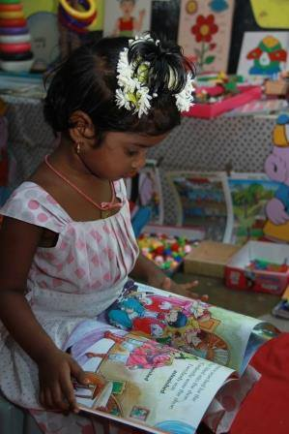
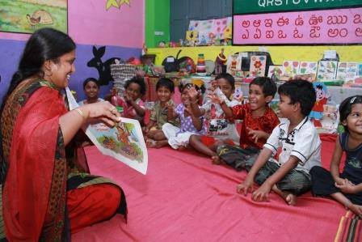


Talking & Listening | Understanding Print | Knowing what books are | Knowing about the alphabet | Understanding sounds and words
☺ |  |  | ABC | ⇨
Numbers & Counting | Patterns | Sorting & Classification | Comparison & Measurement | Geometry/ Spatial relations
123 | ○○○ |   |  | ⬇
Notes:
About five years ago we Save the Children carried out a reflection exercise on what we are doing to support foundational skills of young children. We had been implementing ECD programs for over 2 decades and had great play based practices and curriculum however upon closer look it didn’t seem that we were intentional enough in our focus on strengthening these critical skills. So we slowly began building on the play based curriculum we had developed and integrating more focused games and activities that aimed at supporting early lit and math skills. We focused on 5 key areas for math-

Slide 20
EL 3 – Easy
I See
Description: This is a guessing game that develops vocabulary and ideas. Teacher demonstrates how to give clues about the characteristics of something in the room, and then small groups of children play the game together.
Materials | None
Primary Skill | ☺ Talking and Listening
Secondary Skill | ? Sorting & Classification, Comparison & Measurement, ⬇ Geometry
Instructions | Say “Let’s look at this table. What words can we use to describe this table? What color is it?” Let the children answer. Then ask more questions about the table: “How does it feel?” [Hard] “How many legs does it have?” [Four] “What other words can we use to talk about it?” [Flat, big etc.]. Say, “Now that we have practiced describing an object, or talking about what it is like, let’s play a game called ‘I see?’” Explain the game to the children: “I am going to look around the room and find one thing that everyone can see. I will tell you some things about the thing that I see, and you will try to guess what it is. Does everyone understand?” Allow the children to ask questions if they don’t understand. Choose an object in the room and describe it. For example, choose the blackboard (but don’t tell the children). Say “I see something that has four corners. It is black. It is hanging on the wall. What do you think I see?” Give the children a chance to guess. They will probably guess correctly that it is the blackboard. If they don’t guess correctly, let them ask questions like: “Is it made of wood?” or “Is it on the floor?” Let them ask three questions then ask them to guess again. Choose another object and repeat the activity. Do this many times, for about fifteen minutes or more, or until the children lose interest.
Variations | Vary the game by playing “I See Someone”, talking about the characteristics of a child in the class (clothing, hair, things the child likes to play, etc.). Be careful not to say anything that may make the child feel uncomfortable. Instead of choosing the object and letting the children guess, ask the children to get into pairs or small groups and do this activity with their partner/group. They can take turns to guess. Try this activity outside as well as inside the classroom. Use Activity EL2: Describing an Object before this one to help the children learn to describe an object.

Slide 21
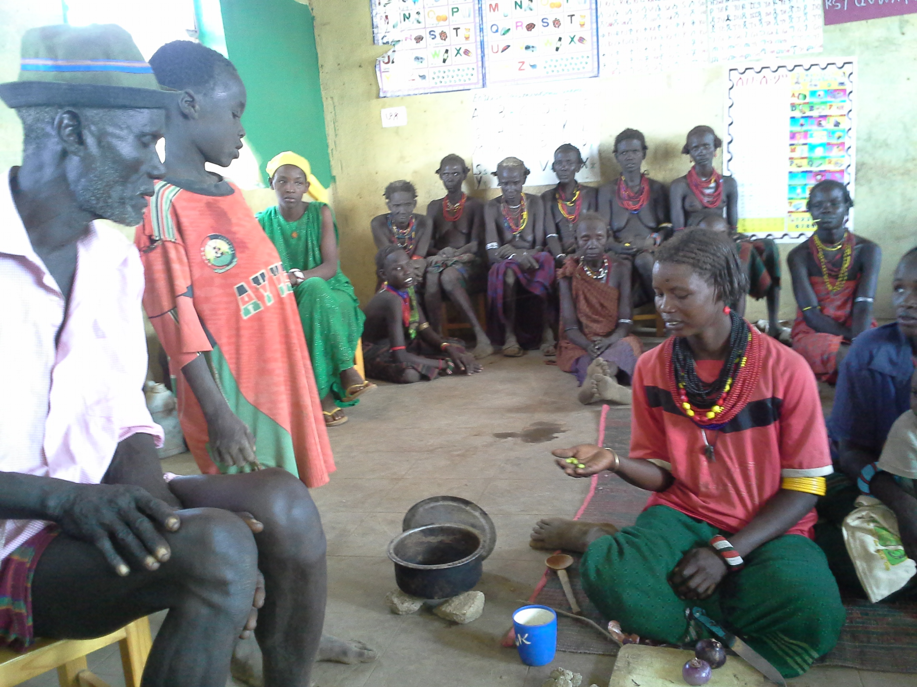
Key features of the Parent Component
Content: Eight sessions of ELM at Home, with practice of games and practical activities during the sessions; Sessions are thematic and cover 3 games in each session, plus a reading/book exchange every session
Frequency: monthly, weekly
or bi-weekly
Session Facilitators: Parent
volunteers, Preschool Class Facilitators or in some cases School Directors
carry out the parent sessions
Supporting Activities:
Visual Parent Cards with games,
Use of Lending Book Bank,
Child participation in sessions
Dessenech volunteer parent trainer
showing other parents how to teach
counting while cooking

Slide 22
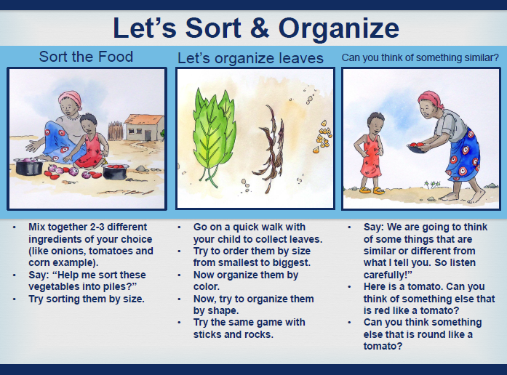
Notes:
At the heart of that is a set of visual resources that is adapted by each country with games that parents can play at home with their children. These are simple, flexible and easily extendable games – that can be integrated into a family’s daily life and routine. The sessions are topica; and

Slide 23
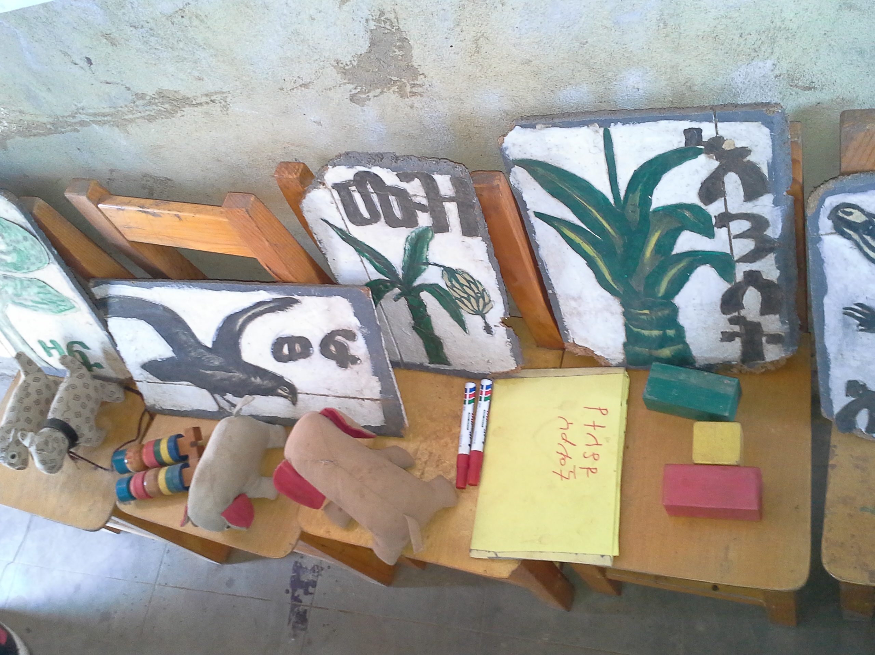
Training Materials-Curriculum for ELM
Emergent Literacy and Math toolkit-
Includes the following integrateable into any curriculum:
  Teacher Training Guide,
  Training of Trainers Guide,
  ELM at Home Parent Training Session Guide,
  100 Activity Cards for Parents,
  8 Picture Cards for Parents,
  over 100 simple stories with illustrations that can be translated into local language for reprinting
  Power point slide decks ready, to accompany all training sessions
  Monitoring and Assessment tools

Slide 24
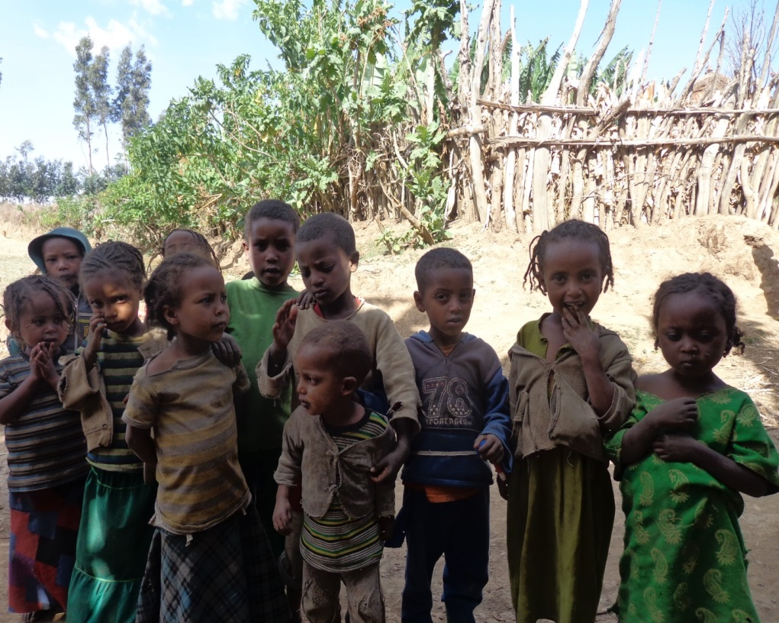
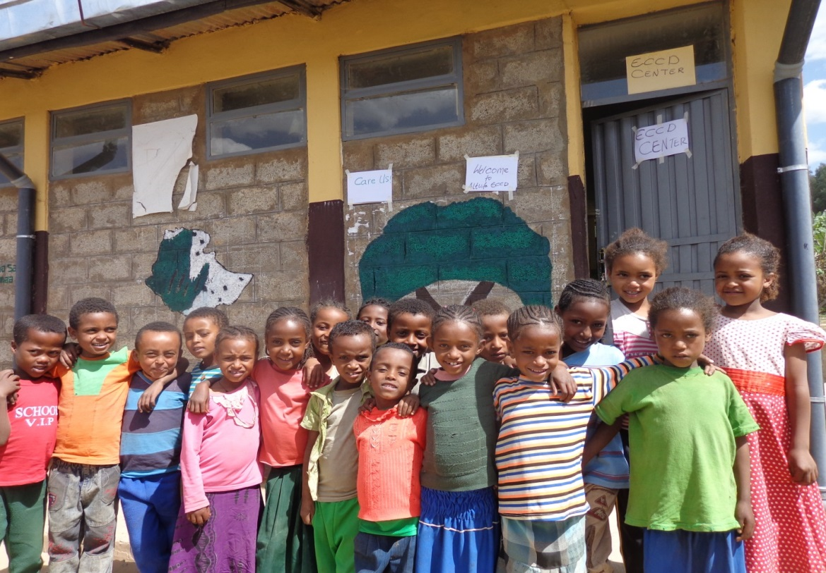
One Example: West Showa Achievements
# of trained ECCD teachers increased from 34-116 (71%)
Parents’ involvement in ECCD program increased from 161to 812 (80%)
Number of children directly reached increased from 1,462 to 6,041 (76%)
Number of ECCD children Promoted to Grade 1 increased from 708-1,328 (47%)
96% of ECCD children who attended grade 1 promoted to grade 2
# of centers fully supported by ECCD program packages increased from 34-101(66%)
Successfully tested in 36 centers in 2012/13 and implemented in 101 centers
Remarkable results achieved from IDELA(International Development for Early Grade Assessment) in 2014/15
Children at Home
Children in ECCD Center

Slide 25
Ethiopia- Results
Notes:
Ethiopia implements ELM in four different sites

Slide 26
FY’13 ELMI Result-Language Domain Gains

Slide 27
FY’13 ELMI Result-Math Domain Gains
Figure 2 shows again that the ELMI group learns significantly more than the ECCD group, who learns significantly more than the group without any ECD. The no ECCD group makes barely any gain in the course of the five months between baseline and endline.

Slide 28
What do we learn from the data?
EQUITY: Analyses find also that children from poorer or less educated families benefit more from the center-based and parenting interventions compared to children from families with more resources.
NUMBER OF YEARS IN PRE PRIMARY MATTERS: The stronger baseline and endline scores for children in ECCD center groups compared to children in government “O” class group indicates that more than one or more year of preprimary education may result in higher learning outcomes, compared to one year of exposure.

Slide 29
Data can speak to equity issues…

Slide 30
…And program impact

Slide 31
Why the home should be a part of an ECCD program?
Parent engagement with children’s learning, gains by group in West Showa in 2015

Slide 32
Parents’ Role Makes a Difference
Results of this study find that children without access to ECCD centers whose parents attended a parenting program gained early skills at the same or faster rates than their peers in ECCD centers.
Children enrolled in ECD centers whose parents also attend a parenting program gained more than children who are enrolled in ECCD centers with no parental training component.
While their overall scores are still below those of children in communities with access to ECD services, the magnitude of the gains children in ELM Parenting group make is similar or better than those seen for children enrolled in ECD centers.
Further, children who received both ELM Center and ELM Parenting programs show stronger gains than any other group.

Slide 33
Financing of ECCD
Serves children 4-6
Pre-service and in-service trainings receive support by Save the Children
$15.00 per trainee per day for in-service training
$500.00 per trainee per month for pre-service training
$14.00-$15.00 monthly incentives by community contribution
$25.00 monthly incentives by Save the Children through School Management Committee

Slide 34
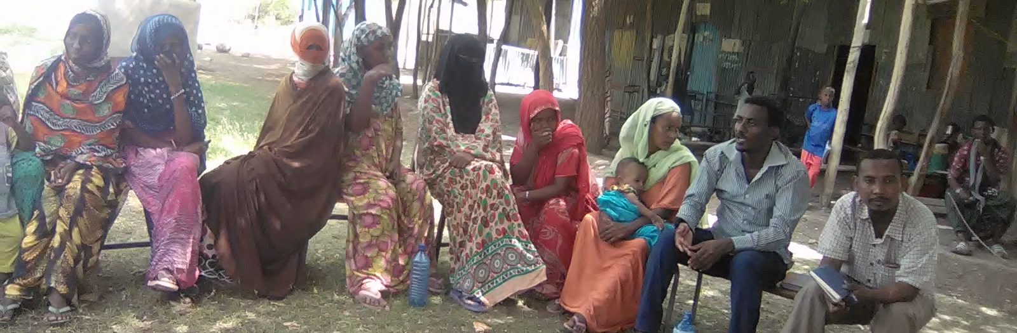
Financing of ELM
1. Teachers’ Training training(5 days basic and 3 day refresher)
  $14.5 per trainee per day for basic and refresher
  2. Training of Volunteer Parent Facilitators
$9.40 per trainee per day (2-3 days)
3. Learning Material Support
$880.00 per center
4. Cost per Child
$38.5 considering 50-60 children
Afar parents meeting for
Emergent Literacy and Math

Slide 35
Major Challenges
Lack of fund/monthly salary for facilitators/teachers
Lack of adequate facilitates/allocation for early education (centers, teachers, playground, resources)
Pre primary still not included/mainstreamed in the regular school structure
Less attention to pre primary at all level (in practice)
No standardized facilitation guide-for facilitators
Lack of understanding of how important parental outreach is to success of ECD and later education outcomes

Slide 36
Conclusions
Emergent Literacy and Numeracy is a low-cost program that enhances the learning outcomes of children in O class
Conducting Emergent Literacy and Numeracy at Home with parents of O class children is an extremely effective, but low cost way to boost children’s learning outcomes and school readiness, especially since getting ECD services to all children in Ethiopia will take time.
While the initial focus is to operationalize all O class, Ethiopia’s economy and learning outcomes will improve when pre-primary is offered to an earlier age group.

Slide 37
kanis@savechildren.org
Ali.amente@savethechildren.org
tizazu.asare@savethechildren.org

