Slide 1
Emergent Literacy and Math & IDELA

Slide 2
Agenda
What is ELM?
What is IDELA?
Lessons to date:
What works for ECD
Impact on primary education
Cost per child
Conclusions and next steps

Slide 3
Emergent Literacy and Math (ELM)
A toolkit for raising early childhood quality interactions to support learning

Slide 4
Emergent Literacy and Math (ELM) Toolkit
Boost the focus on language and early math in preschools
Boost parents’ confidence and capacity to support children’s learning at home
Provide ample access to children’s books and math materials
Preschool: ECD Educators Training Toolkit
An activity bank with100+ early literacy & math games
Home: Parent Education Toolkit
8 sessions
25 + games
Books
Manipulatives
Notes:
Quality enhancement toolkit focused on strengthening foundational early literacy and math skills
What makes this toolkit unique
Practical nature of the materials
The dual foci
The simplicity of implementation
The focus on ELM which makes it easy to integrate and bring into other teacher training or parent education packages

Slide 5
ELM Target Skills
 | EMERGENT LANGUAGE & LITERACY SKILLS
 | Talking & Listening | Understanding Text | Understanding Books | A to Z | Understanding Sounds
SYMBOL | ☺ |  |  | ABC | ⇨
TECHNI-CAL TERM | Oral Language Development | Print Awareness | Book Awareness | Alphabetic Awareness | Phonemic & Phonological Awareness
 | EMERGENT NUMERACY SKILLS
 | Space | Sorting | Patterns | Time | Problem Solving | Numbers
SYMBOL | ❒ |  |  |  | ? | 123
TECHNI- CAL TERM | Spatial Concepts | Sorting and Classification | Patterns and Seriation | Concepts about Time | Problem Solving | Number Sense
Notes:
The toolkit targets 5 emergent language and literacy and 6 emergent math skills using cooperative games, explorations and physical activities to enhance social-emotional as well as physical development too.

Slide 6
ELM Activity Card Example
Friendship Hunt
STANDARD | 3.3 Children are able to demonstrate the awareness of print concepts and love for reading 3.4 Children are able to demonstrate interest and ability in writing
CATEGORY | Teacher Led/Corner Activity/Independent Work
LITERACY SKILL | ABC Alphabet Knowledge
SECONDARY SKILL | ●●? Sorting & Classification
MATERIALS | Treasure hunt sheet (see instructions below), writing instruments Preparation: On a piece of paper, one for each child, make a list of characteristics of children (e.g. wearing blue, has long hair, etc.)
ACTIVITY | Say, “We’re going to go on a treasure hunt today. You are going to look for the things that are on your lists. Give each child a treasure hunt sheet. Say, “Walk around the room and look for people with the following characteristics. You may need to talk to them. Every time you find someone with this characteristic, make a mark on your sheet like this.” Demonstrate with the first example. Once the children are done, about all the things on the list! Ask, “Who did you find with _______?” Put extra sheets in the literacy corner for the children to try during Corner Time.
LEVEL | BASIC | MIDRANGE | ADVANCED
 | Make sheets with pictures and words together Choose characteristics that are easier to identify (e.g. is a boy) Have them make any mark they can around or by the item (circle, X, line—whatever they are capable of) Pair children up so they can work together. | Use a mix of pictures with words and words only Choose slightly more challenging characteristics (e.g. has a sister, wears black shoes, is five years old) Make a more complex mark near the item or try to write some letters by each one, use their initials | Use sheets with words only, or more advanced words with pictures (curly hair, wearing purple, wearing a necklace, favorite animal is ____) Choose slightly more challenging characteristics (e.g. name starts with an M, name ends with A], brown hair, has 2 sisters, has a dog) Have them “sign” the other child’s paper
Notes:
Explain example

Slide 7
Notes:
This is an example emergent math activity card adapted for use in Bangladesh. The activity is comparing and measuring and both pictures and words facilitate use by parents both literate and illiterate.

Slide 8
ELM Toolkit Use
Currently implementing in 18 country sites
In diverse contexts and with varied populations
Countries in Red are places where we are also building evidence around ELM
IDELA instrument is used for tracking impact
Afghanistan
Bangladesh
Bhutan
China India
Indonesia
Nepal
Pakistan
Philippines Vietnam
Egypt Ethiopia Lebanon Mali
Rwanda
Malawi Mozambique Uganda

Slide 9
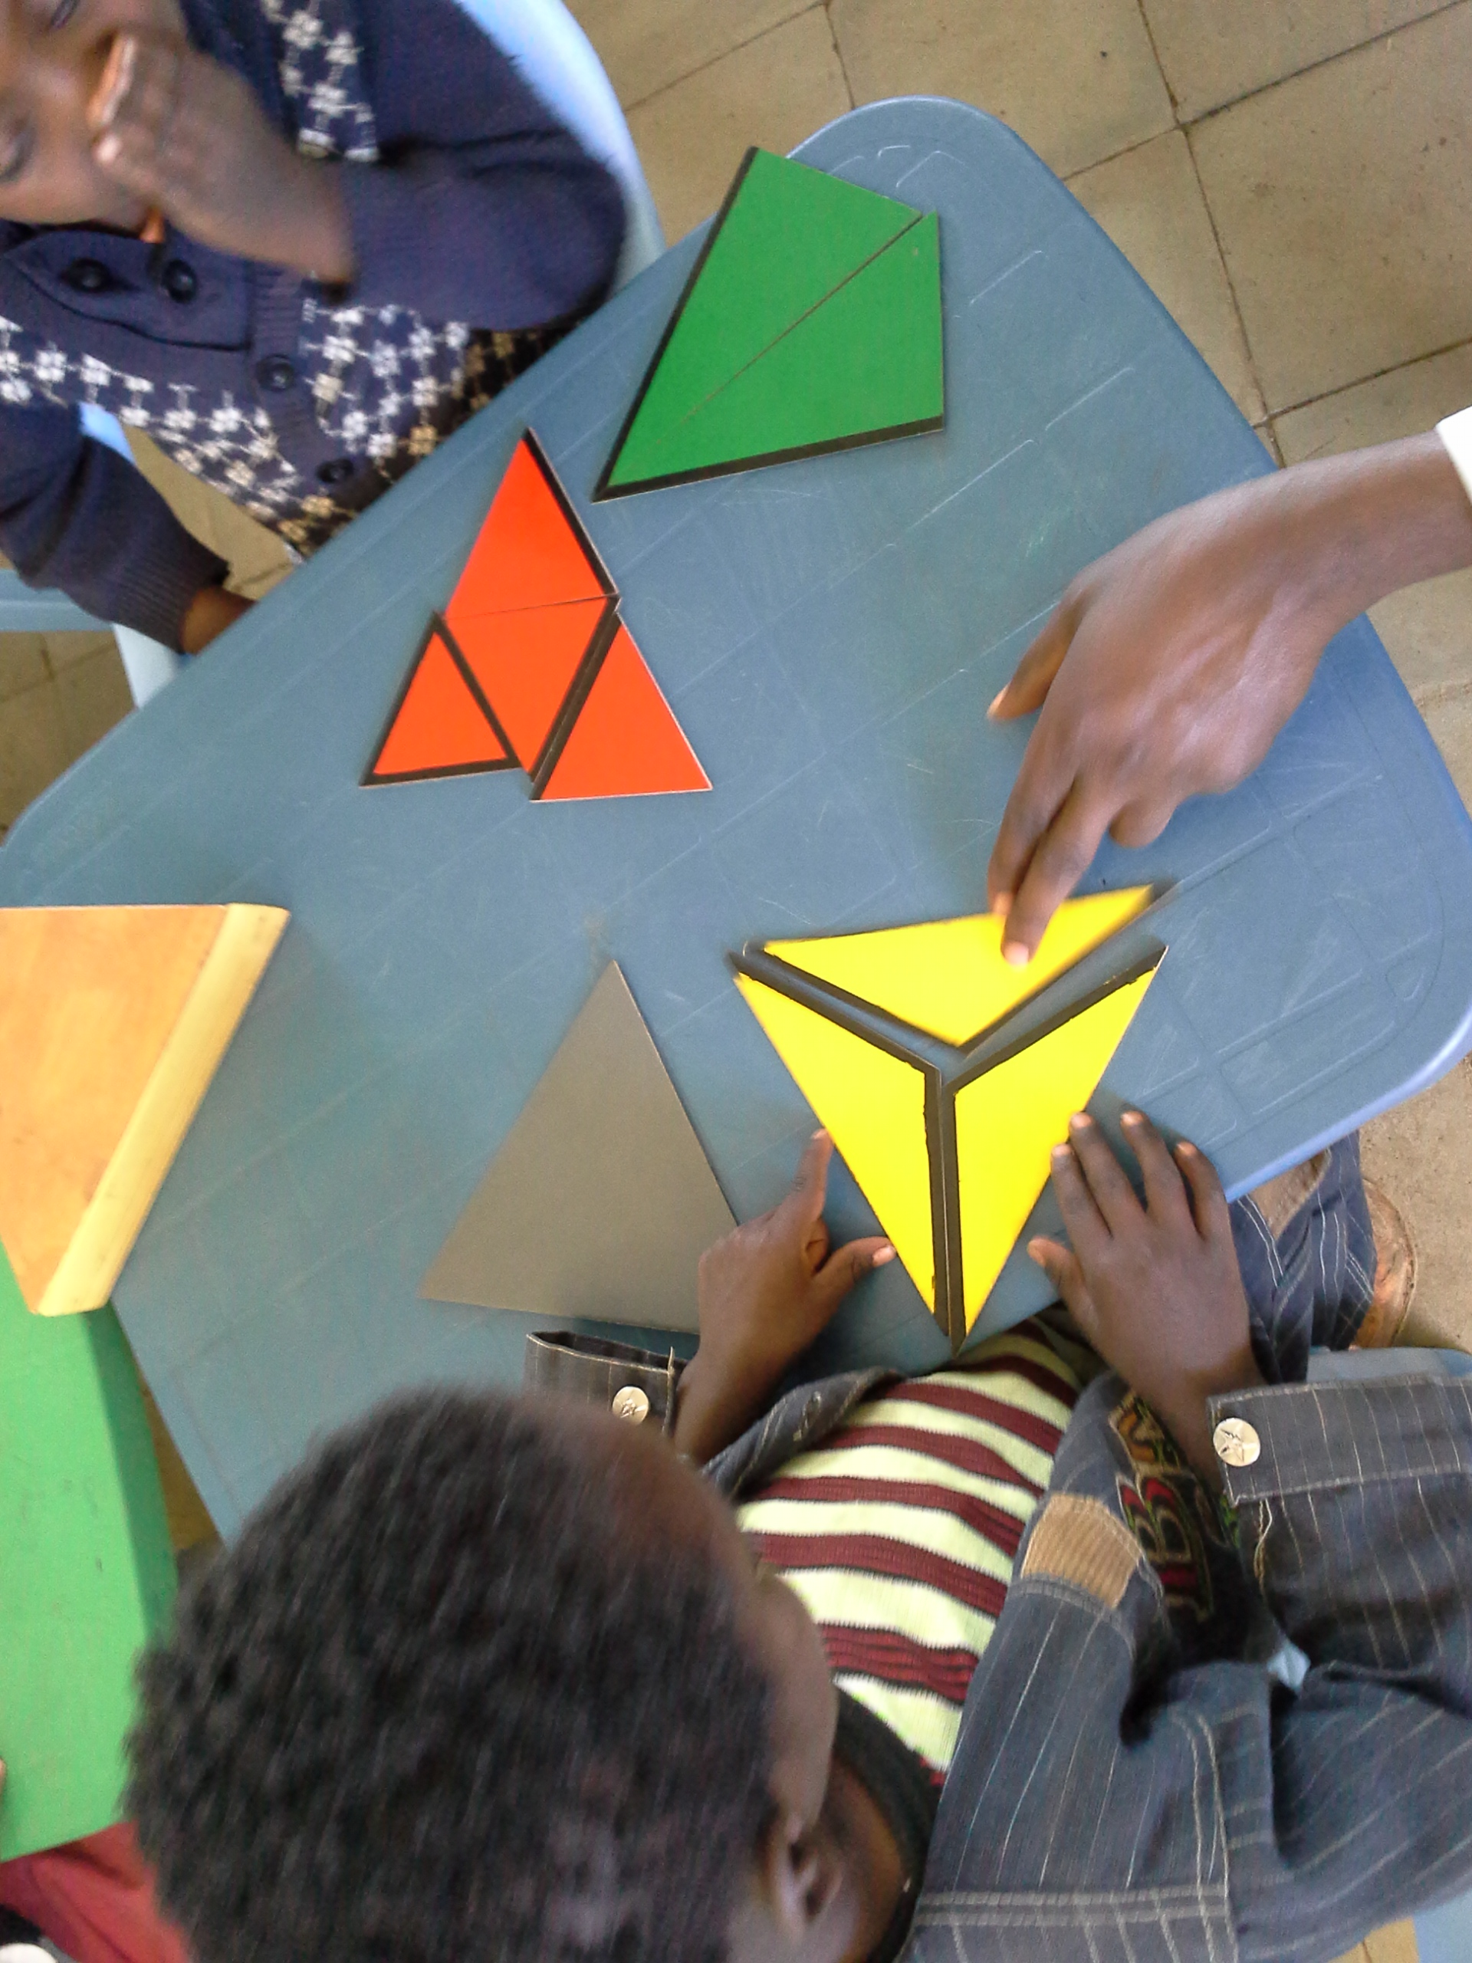
ELM adaptability
Can be grafted on to any existing ECCD center-based program
Can be implemented through multiple systems
Can be used by multiple delivery agents
These variations enable us to:
Test enhanced center quality
Test adding parenting to centers
Test parenting versus centers

Slide 10
International Development and Early Learning Assessment (IDELA): A single metric to build evidence
Notes:
To do this testing, we need a reliable, rigorous way to measure impact

Slide 11
Common Metric: IDELA
Motor Development
Print Awareness; Oral Language; Letters; Phonological Awareness; Listening Comprehension
Emergent Math/ Numeracy
Socio-Emotional Development
Perspective taking; Understanding feelings; Self awareness; Sharing; Peer interactions;
Fine and gross motor skills: Hopping; Copying shape; Folding paper; Drawing
Number Sense; Shapes & Spatial Relations; Sorting; Problem Solving; Measurement & Comparison
Emergent Language and Literacy
Notes:
To look across program types and sites, we use a common measure – IDELA. It’s internal consistency and reliability is good and its structure shows four domains that contribute uniquely to an overarching domain you might call school readiness
Play based, direct child assessment
Target age: 3.5 - 6.5 years
# Items: 24 core items that cover 4 domains, approaches to learning and self regulation
.

Slide 12
Internal consistency
Motor Development
α=.82
Emergent Math/ Numeracy
α=.83
Social-Emotional Development
α=.77
Emergent Language and Literacy
α=.84
Overall α=.90

Slide 13
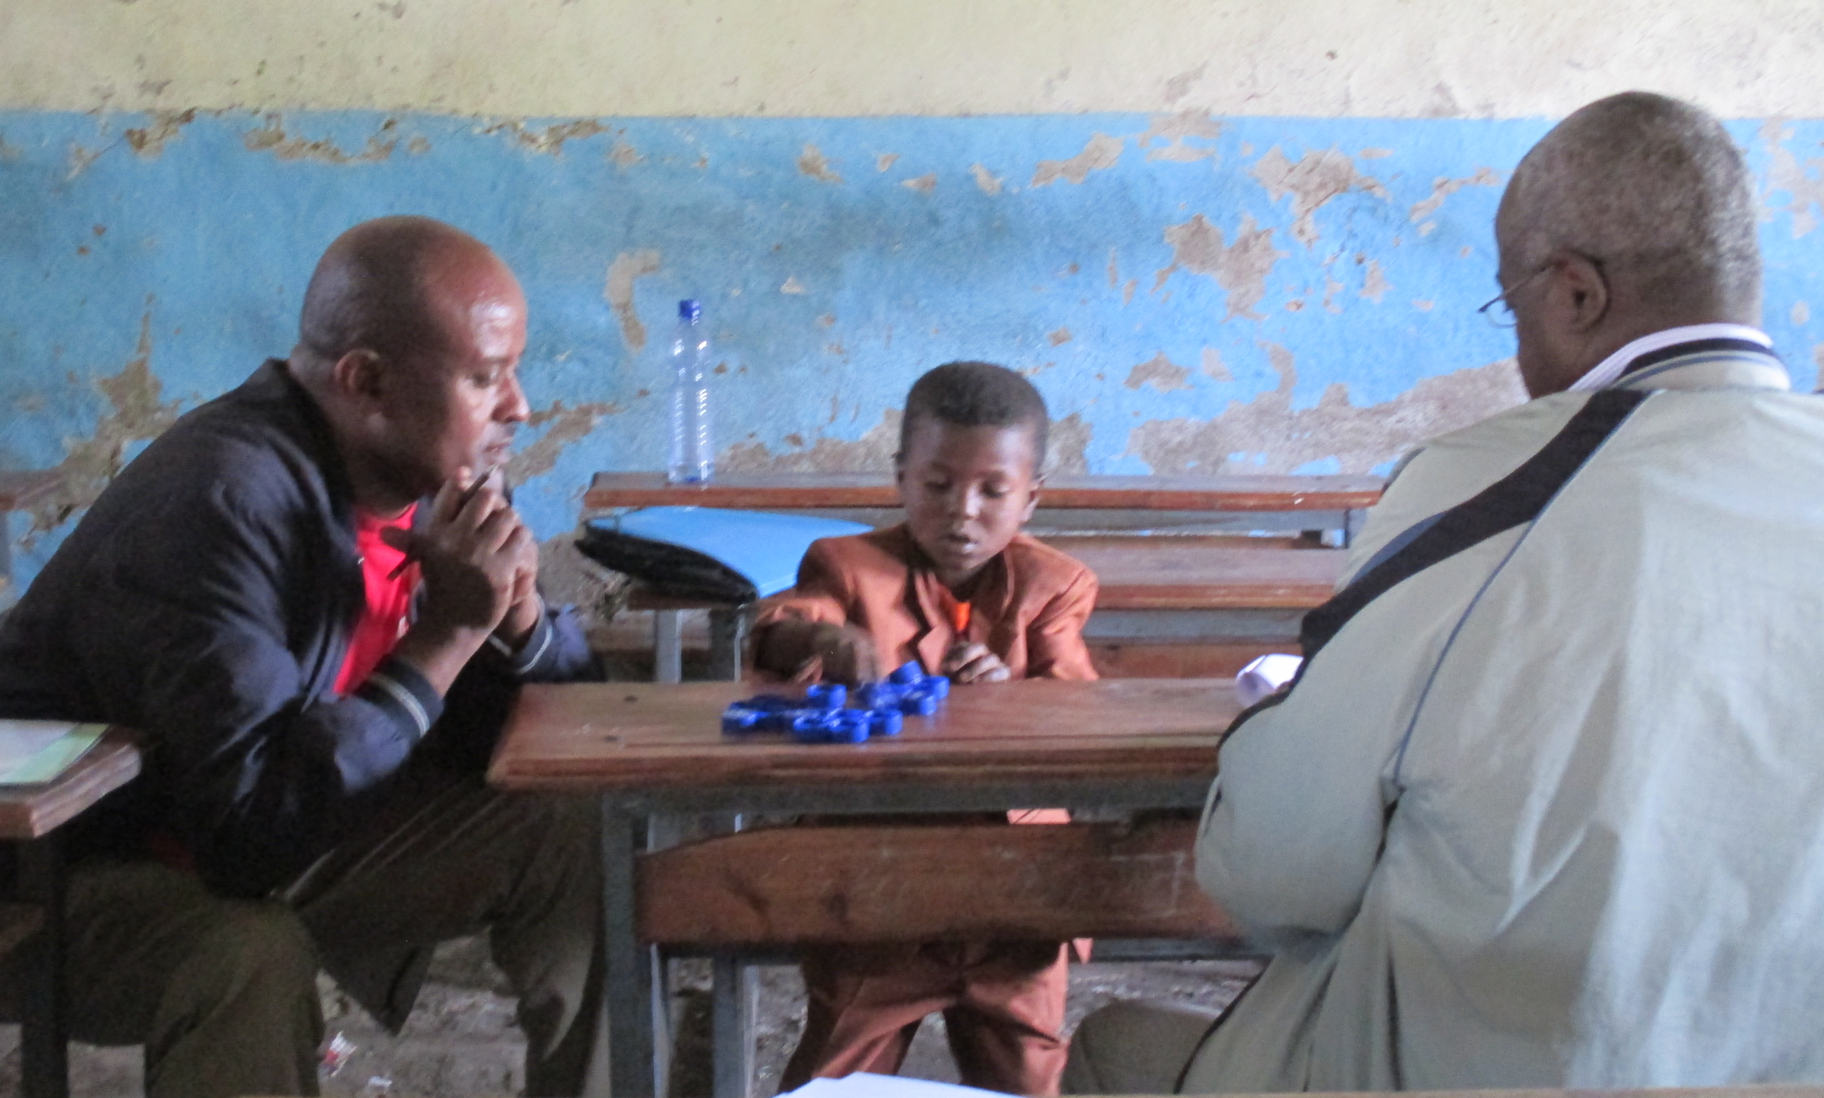
Inter-rater reliability
Intra-class correlations
 | Malawi | Egypt | Zambia | Bangladesh | Rwanda
Motor Development | 0.89 | 0.93 | 0.94 | 0.99 | 0.79
Emergent Literacy | 0.89 | 0.88 | 0.95 | 0.97 | 0.90
Emergent Numeracy | 0.88 | 0.87 | 0.97 | 0.97 | 0.88
Social-emotional Development | 0.89 | 0.90 | 0.95 | 0.99 | 0.80
Notes:
IDELA consistently shows high levels of inter rater reliability – which is quite encouraging given the fact that data collectors across settings have varied levels of experience and education levels

Slide 14
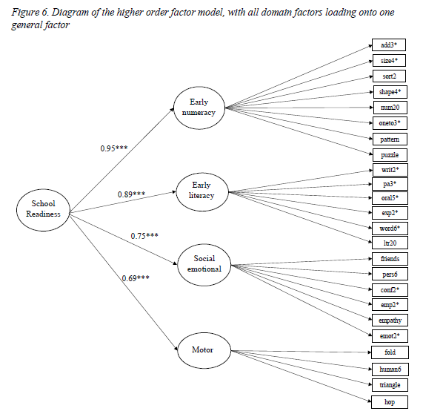
NYU Global TIES: Exploratory/Confirmatory Factor Analysis
Notes:
NYU’s factor structure analysis shows all four domains load onto a general factor and we are seeing the overall factor structure holds up well across 5 countries spanning across four global regions (South America, SSA, East Asia, and Central Asia; and that the factor structure appears to be largely similar across contexts with the exception of some individual items which don't have a lot of variation (e.g., what is your name?).

Slide 15
Iterative evidence about what works for ECD

Slide 16
Ethiopia: Phase 1
Notes:
RCT to raise quality in preschool settings in Ethiopia was a success, but also showed that lack of access is a big problem. The comparison group stood out – challenging our team to think about children’s opportunities in the many places where no ECCD programming exists. ECCD expansion should not be undertaken institutionally without an eye on quality.

Slide 17
Ethiopia: Phase 2
Notes:
Phase 2 featured a parenting version of the program – both as a stand alone where no center existed, and in combination with the ELM O class from phase 1. This evaluation also took place during a shift in government policy that included the promotion of “O classes” in every primary school as a year prior to school entry.
In these results, we see that children in centers in which parenting was added to the center based work had significantly greatest gains, and that those with a quality parenting program alone gained as much as those in a good quality ECD center. The children in the O class gained the least.
Questions for scale that follow this –
* how can we scale parenting cost effectively?
* how can we improve more O classes cost effectively?
Question for implementation: what is driving this?

Slide 18
Ethiopia: Into the black box
Notes:
Here is a hint at what might be behind the results – it looks like there is a substantial transformation in the enabling environment of children in the parenting groups. But more implementation fidelity data is needed.

Slide 19
ELM and Equity
Rwanda. Average Endline for ELM Parenting, ELM Centers and Comparison Centers
Notes:
In both Ethiopia and in Rwanda, we have seen an equity effect in which the children from poorer homes excel in centers implementing ELM as compared to those in more traditional ECD settings. In Rwanda, this figure shows that was the case for ELM Parenting as well since the lower SES children are near or a bit higher than their better off peers at endline, while in the comparison preschools the children with the highest SES have the highest endline IDELA scores.

Slide 20
Impact into primary school years

Slide 21
Rwanda ELM – duration of impact
Notes:
By the second term of grade 1:
ECD and parenting are similar
No ECD is getting further behind
Mid-endline gains are modest – impact of transition into school of ? Quality
Low overall endline
At midpoint, we took a look at mechanisms at work…

Slide 22
Bangladesh
ELM children are three times more likely to be in the appropriate grade compared to their peers with no ECCD support.
ELM graduates in
Grade 2
No ECCD children in Grade 2
Notes:
IN Bangladesh, the ELM graduates are not only more likely to be in the appropriate grade, they are also scoring significantly higher on literacy and math assessment in grade 2 compared to their non eccd peers in Bangladesh.

Slide 23
IDELA: informs program improvement
Notes:
We also use IDELA to look across implementation efforts to inform toolkit revision – as in this figure that the ECCD team used to think about which parts of an emergent language and literacy skill profile could be better supported. Overall ELM 2.0 will also have a greater emphasis on SEL.

Slide 24
Low Cost

Slide 25
Costs and Resources
Center-based ELM
In Rwanda, add on to government provision as a quality enhancement, delivered through existing system but supported by SC
$25 per child per year with intensive support
$10 per child in a less intensive support
In Bangladesh, where ELM is delivered at much larger scale through government system and officials the cost is lower and decreases the bigger the scale
$10-12 per center/classroom per year – 37 cents per child per year
ELM Parenting
In Rwanda, where this is a stand alone program at the moment, $9 per child per program cycle
In Bangladesh where parenting is tagged onto existing center based program, the costs are marginal
Notes:
more intensive support is extra materials, more trainings, deeper engagement to the teachers. less intensive is a lighter touch of how much time and resources we equip the classes with. We do NOT pay the teachers in either place

Slide 26
SUMMARY
ELM integrates language, literacy, math and interpersonal cooperation to holistically enhance children’s readiness to excel in school and life. We need to extend such opportunities with an eye on cost and quality.
ELM impact can be generated via several different delivery systems and is demonstrated using IDELA. We next need to explore in more detail how these impacts compare in more countries and at different levels of implementation intensity.
ELM is a low cost way to contribute to SDG 4 – being better prepared for and excelling in primary school. We need to document more directly its cost effectiveness both within ECD settings as well as its potential systemic savings in the primary years.

Slide 27
Questions and inquiries to: spoehlman@savechildren.org

